Slide 1
Neuro-Ophthalmology: Brief Overview
Usma Chatha D.O.
Sarasota Retina Institute

Slide 2
I have no financial disclosures

Slide 3
Part 1: Diplopia - Worry or Not

Slide 4
Objectives
Approach to patient with diplopia
HPI
Systemic Symptoms
Exam
Localization

Slide 5
Objectives: Localization
Double vision with Patterns:
Cranial Nerve palsies -
CN III
CN IV
CN VI
Comitant deviations
Double vision without Patterns:
Giant Cell Arteritis
Thyroid Eye Disease
Myasthenia Gravis
Skew Deviations
Miller Fisher Syndrome
Internuclear Ophthalmoplegia
Paraneoplastic Disorder

Slide 6
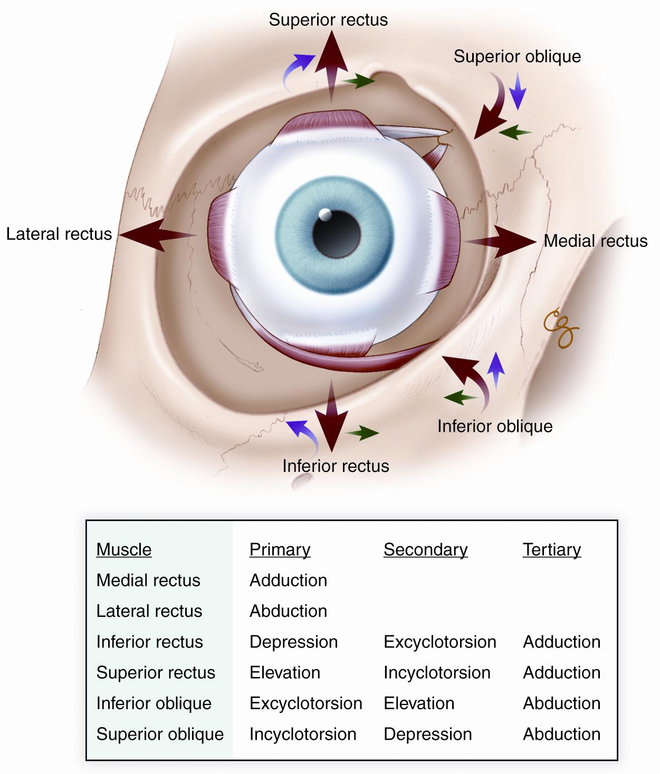
HPI
Diplopia Conditions
Binocular vs. Monocular
Duration
Constant, intermittent, transient
Distance
Near, Far, Both
Direction
Vertical, Horizontal, Oblique

Slide 7
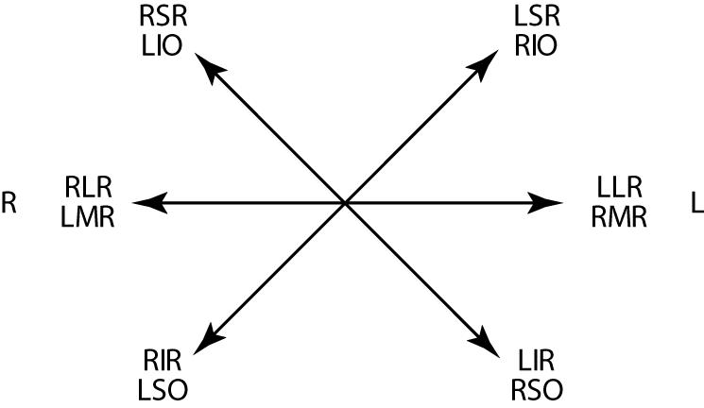
Depending on the horizontal position (abduction or adduction) the primary position of the vertical muscle may change.
E.g. Adduction → IO = primary elevator & SO = primary depressor
Review, O. (2019). Extraocular Muscle Anatomy — Ophthalmology review. Ophthalmology Review. https://www.ophthalmologyreview.org/bcsc-fundamentals/eom-anatomy

Slide 8
Monocular Diplopia
Take a breath
Two images viewed by a single eye: overlapped images
Light Diffraction
1 image falls directly on the fovea
1 image on extra-foveal retina of same eye
Resolves via pinhole
Metamorphopsia = Retinal pathology
E.g. macular edema
Epiretinal membrane
Cerebral polyopia: Perception of multiple images
Pathologies involving occipital cortex or central visual pathway
Bilateral monocular diplopia: equal clarity without overlap

Slide 9
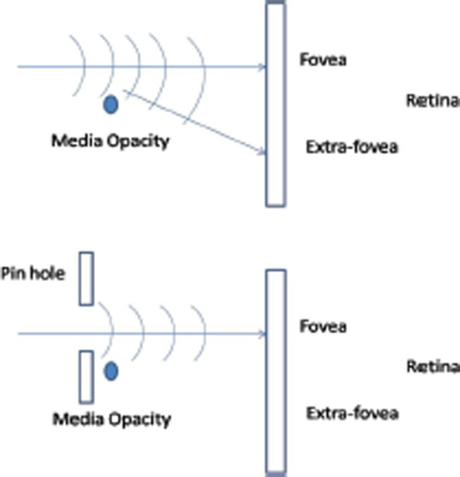
Tan, A. (2010). The Two-Minute Approach to Monocular Diplopia. PubMed Central (PMC). https://www.ncbi.nlm.nih.gov/pmc/articles/PMC4170412/

Slide 10
Approach to Diplopia
Systemic Symptoms
Scalp tenderness, jaw claudication, fevers, night sweats, unintentional weight loss, fatigue, joint pains
Exercise/activity threshold decrease
Headaches, pulsatile tinnitus, transient visual obscurations
Pain (at rest or with movement)
PMH/POH
Amblyopia (patching, “lazy eye”)
Thyroid history
Recent illness, trauma or surgery
Vascular risk factors
Cancer

Slide 11
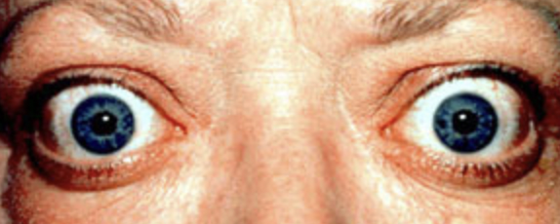
Diplopia Approach: Exam
Eyelids
Pupils
EOMs
Proptosis
Notes:
Lids: Retraction, lag, Cogan’s lid twitch or fatigue
Proptosis - orbital process (TED, mass, etc)
Pupils - check for anisocoria → Horner’s, CN III

Slide 12
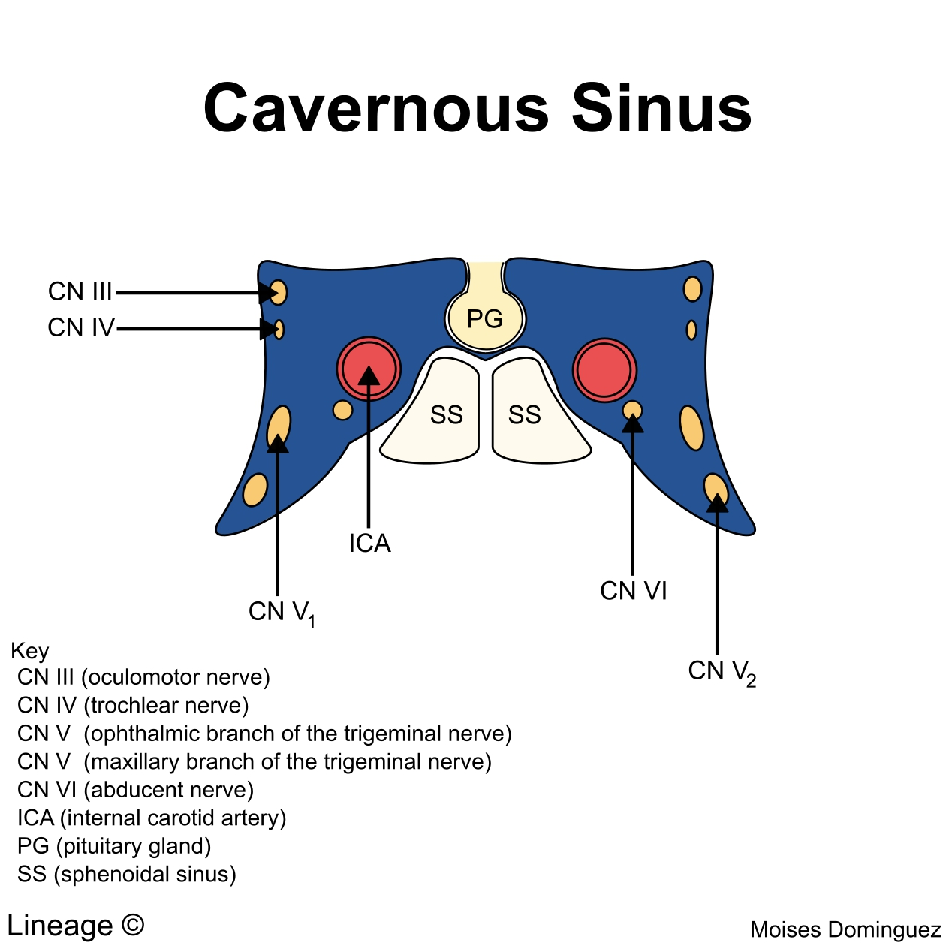
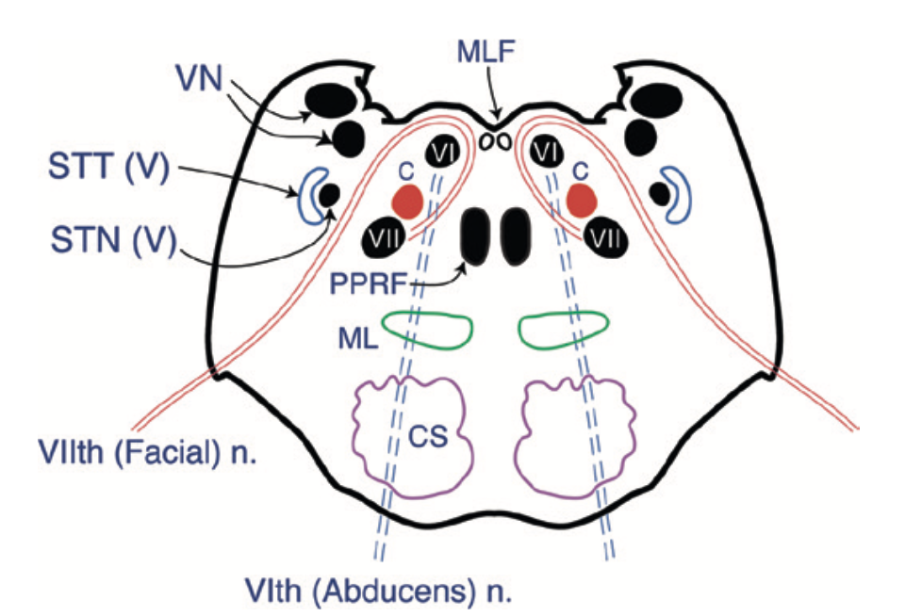
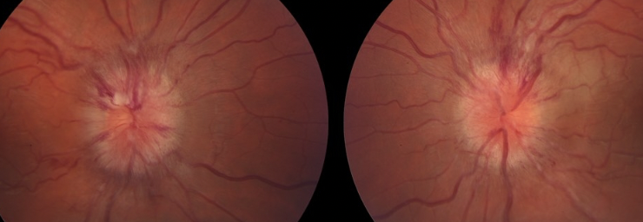
Diplopia Exam
Head position
Sensorimotor Exam
Cross Cover
Maddox Rod
Is it a mononeuropathy?
Fundus Exam
Maculopathy
Optic nerve edema
? Papilledema = optic nerve edema OU
https://morancore.utah.edu/basic-ophthalmology-review/disc-edema/

Slide 13
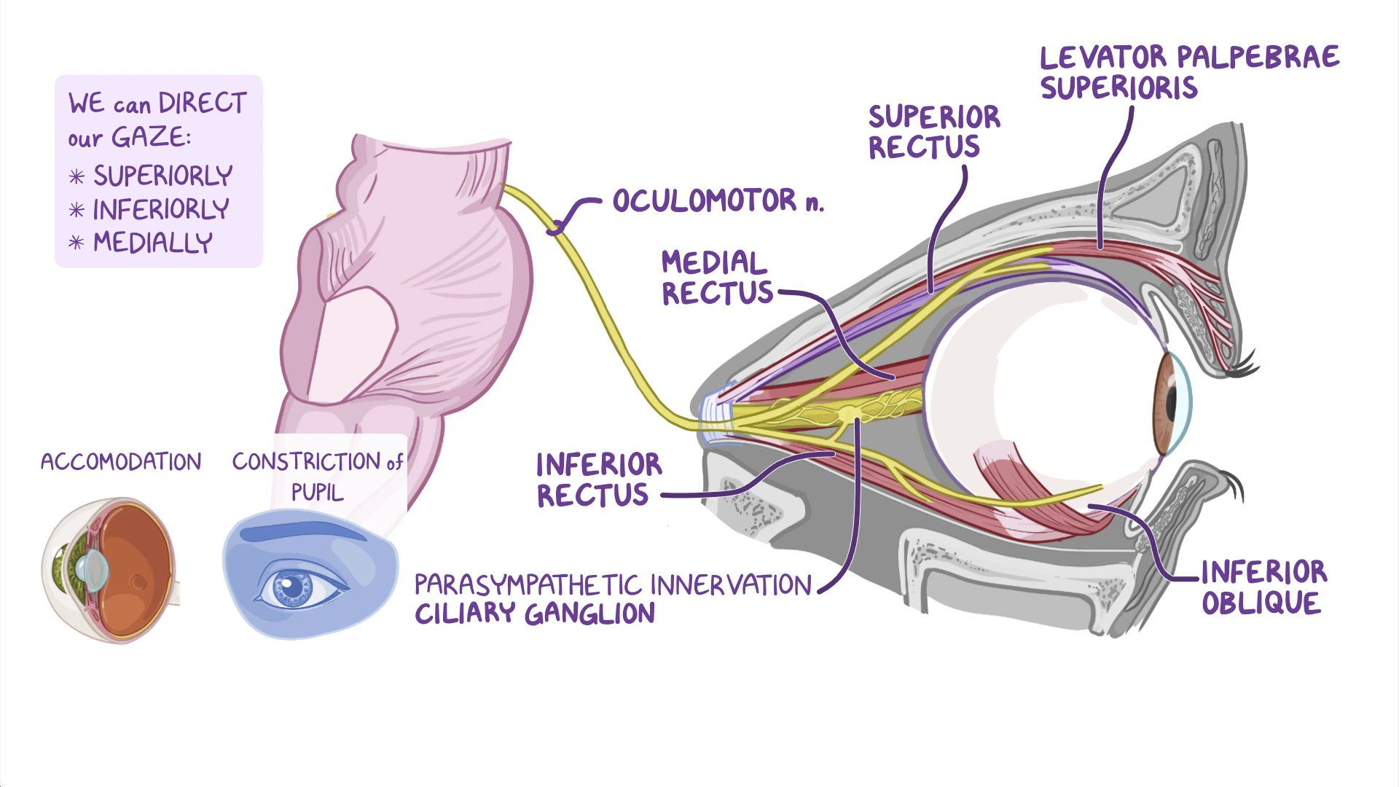
Oculomotor Nerve (CN III) Palsy
Incidence of acquired CN III palsy in US population based survey by Chengbo et al: ~4 per 100, 000
Controls 4 out of the 6 extraocular muscles
Complete CN III palsy = Complete ptosis with “down and out”
Ptosis present in ~86% of patients at presentation
Pupil involving vs. Pupil sparing
43% of patients on presentation
Notes:
CN III: leaves the cranial cavity via the superior orbital fissure dividing into superior and inferior branches
Superior branch → SR and levator
Inferior branch → IR, IO and MR; pre-ganglion parasympathetic fibers to the ciliary ganglion → ultimately innervates the pupillary sphincter & ciliary muscles

Slide 14
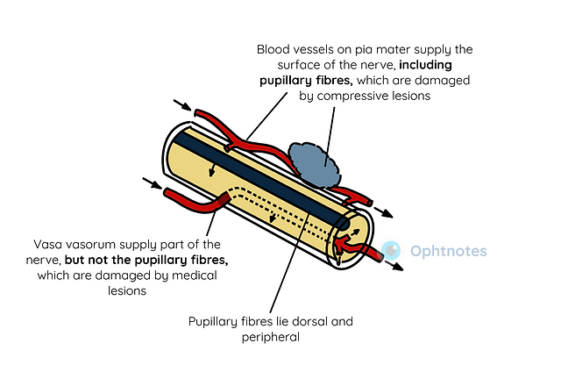
CN III Palsy: Causes
Vascular Ischemia (“microvascular CN palsy”) ***
Trauma
Structural Causes:
Increased intracranial pressure → pushes the nerve against the temporal bone
Cavernous sinus infections/trauma
Posterior Communicating Artery (PCoM) Aneurysm
Less commonly: posterior cerebral artery or superior cerebellar artery
Hemorrhage
Subarachnoid hemorrhage in vicinity of an aneurysm
Extradural hematoma → tentorial pressure cone and herniation of the temporal bone
Compression of third nerve
Painful

Slide 15
CN III - Aberrant Regeneration
Oculomotor Synkinesis
COMPRESSIVE lesion
Tumors
cavernous or parasellar meningioma most commonly
Aneurysm
Trauma
Elevation of the upper eyelid with attempted downgaze or adduction
Adduction of the eye on attempted upgaze or downgaze
Pupillary constriction on attempted adduction

Slide 16
https://www.youtube.com/watch?v=FxfCSkbVDFc&ab_channel=MoranCORE

Slide 17
Mononuclear Cranial Nerve palsies
Microvascular Cranial Nerve Palsies (MCNP)
Most common cause of acute double vision in the older population
> 50 y.o
Risk factors: Hypertension, Diabetes, Hyperlipidemia, Coronary Artery Disease
Affect the vaso vasorum thus sparing the pupillary fibers
Damage is not permanent therefore regenerate over 6-12 weeks without any sequelae

Slide 18
CN III Evaluation & Management
COMPLETE CN III pupil-sparing palsy
Microvascular risk factor management by PCP
GCA labs
MG labs
Follow more frequently in the beginning (?6 wks then 3 months)
Most note improvement between 6-8 weeks
Complete recover in 3 months (upto 6 months)
Patching
Botox (Botulinum toxin to lateral rectus)
Surgery: wait at least 6 months
Pupil-Involving CN III palsy or INcomplete CN III pupil-sparing palsy
MRA Head*
MRI Brain/Orbit WWO

Slide 19
CN III: Sample Case
61 yo presenting with LUL drooping and binocular diplopia x 10 days
Gradually worsening
Painful
PMHx: DM (last A1c 8.2), HTN

Slide 20
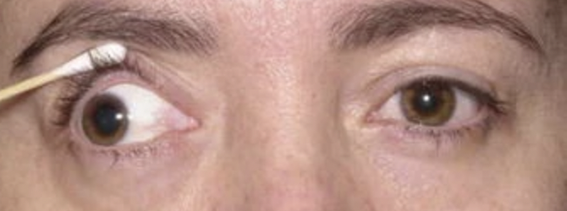
CN III palsy: Sample Case
<
100
0
5 → 3
Pupils
7 → 7
100
100
0
100
100
0

Slide 21
Case 1
MRI/MRA Head:
No definitive intracranial aneurysm/stenosis present
Mildly motion degraded
GCA labs: wnl
Could this be microvascular CN III palsy?

Slide 22
Case 1
Mild Anisocoria (<2mm) in up to 38% of microvascular cases
Rarely dilated and fixed if microvascular
Neuroimaging
CT/CTA: 95% sensitive for > 5mm aneurysm
MRI/MRA: 95% sensitive for > 5mm aneurysm
~54% sensitivity for <5mm aneurysm

Slide 23
Case 1
CTA Head: focal outpouching of L PCoA projecting posterolaterally approximately 9mm from base to apex and 5mm in transverse diameter
Admitted to Neurosurgery
Pipeline flow diversion of L PCoA aneurysm

Slide 24
CN VI Palsy
Supplies a single muscle: Superior oblique (SO4)
Annual Incidence: ~5.73 per 100, 000
Male gender more common in several studies
?higher trauma in males
Etiology
Idiopathic(~49%): most congenital presenting later in life
Trauma (~18%) → long intracranial course make it more vulnerable to injurty
Vascular (~23%)

Slide 25
CN VI palsy
SO → intorsion, depression, and abduction
Park Three Step test
1) Identification of the hypertrophic eye in primary position
2) Identification of they hypertrophic eye in right and left gaze
3) Bielschowsky head tilt test: which head tilt makes it worse.
Hypertropia worst on lateral gaze and ipsilateral head tilt
Subjective measurement
Maddox Rod
Abnormal head position?

Slide 26
CN VI palsy
Congenital Cases
Long standing head tilt
Acquired cases:
No head trauma → MRI
Myasthenia Gravis → rarely
Treatment:
Trauma → observe for 6 months → Surgery
Acute traumatic: Botox → IO
Prism therapy
DDx: Skew Deviation

Slide 27
Skew Deviation
Vertical deviation does not follow any set patterns as in CN VI palsy
Diplopia does not alleviate with head tilt
3 step may falsely point towards a CN VI palsy
Supine-Upright test : specific test to differentiate
Vertical misalignment between two eyes decreased by > 50% on changing position from upright to supine in skew deviation

Slide 28
Abducens Nerve (CN VI) Palsy
Supplies a single muscle → Lateral Rectus
Most common: Incidence 4/100,000
Highest Prevalence: 4278 patients in Mayo clinic study > 30 years with CN VI palsy and undetermined cause
Esotropia worst in ipsilateral gaze and improves in contralateral gaze

Slide 29
CN VI Palsy
Bilateral → Fundus Examination
Increased Intracranial pressure
Idiopathic
Lyme disease
Neuroimaging: Bilateral, <50
Labs: GCA labs, lyme titers, MG
Treatment:
Observation with symptomatic control by patching
Fresnel prisms
Botox: - Antagonist muscle → Medial Rectus

Slide 30
Comitant Deviations
Childhood Strabismus
Decompensation can occur throughout life and maybe associated with:
refractive changes
cataract development vs. surgery
Congenital Palsies with spread of comitance: 4th nerve palsies
Head tilt
Large Vertical fusions
Treatment:
Treat underlying aggravating symptoms
Fresnel vs. Ground in prism
Strabismus surgery

Slide 31
Diplopia without pattern

Slide 32
Thyroid Eye Disease
Exact prevalence unknown
Women: 16 per 100,000
Men: 2.9 per 100,000
Can occur in patients with Grave’s Disease, Hypothyroidism or Euthyroidism
Variable presentation:
Ocular pain
Periorbital swelling
Proptosis
Diplopia
Compressive optic neuropathy

Slide 33
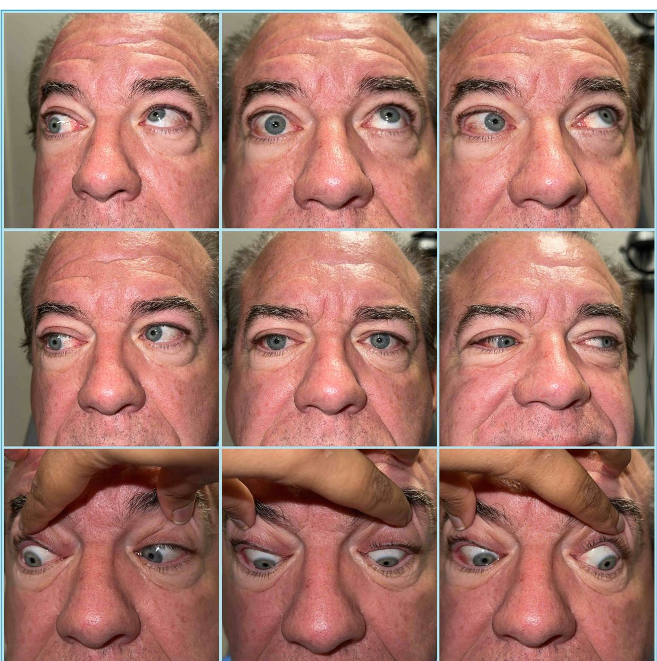

Slide 34
Evaluation of Thyroid Eye Disease
Thyroid Panel
T3 and T4
TSH
Thyroid antibody testing:
Thyroid Stimulating Immunoglobulin (TSI)
Thyroid Peroxidase (TPO)
MRI Orbits to evaluate orbital fat and extraocular muscle

Slide 35
Treatment for Thyroid Eye Disease
Based on clinical signs and symptoms
Observation
Steroids? IV vs. PO
Tepezza
Surgery
Orbital Decompression
Strabismus
Eyelid

Slide 36
Myasthenia Gravis (MG)
Rare acquired autoimmune disease
Antibodies destroy neuromuscular connections resulting in muscle weakness and fatigue
Voluntary muscles of the body
Normal muscles and nerves
Ocular Myasthenia Gravis affects only the ocular muscles
Systemic Myasthenia Gravis: ocular muscles (generally presenting symptom) + other voluntary muscles
~85% of patients presenting with ocular MG will develop systemic MG within 2 years

Slide 37
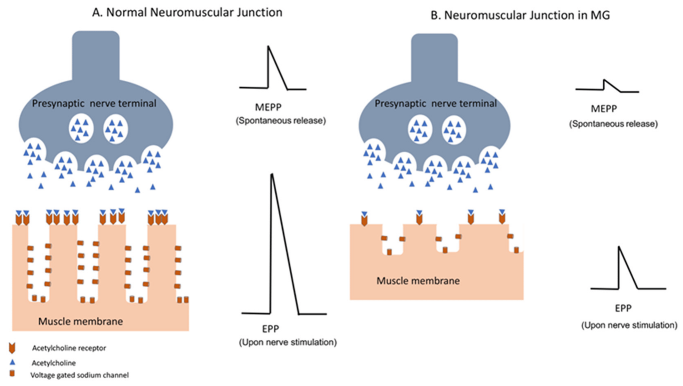
Dresser, L., Wlodarski, R., Rezania, K., & Soliven, B. (2021, May 21). Myasthenia gravis: Epidemiology, pathophysiology and clinical manifestations. MDPI. https://www.mdpi.com/2077-0383/10/11/2235

Slide 38
Ocular Myasthenia Gravis
May present as a CN palsy or without any specific pattern
Variation between exams
Variable recovery course
“Relapsing” episodes
Ptosis WITHOUT pupillary changes +/- fatigability
Ice Test: apply for 2-5 minutes on affected side
POSITIVE test: > 2mm improvement Ocular Symptoms → Ptosis +/- Diplopia
Change in symptoms based on time of day

Slide 39
Systemic Myasthenia Gravis
Ask about “Bulbar” symptoms:
Swallowing → Liquids vs. Solids
Breathing
Muscle Fatigue
Workup:
MG labs (AchR binding, blocking, modulating, MUSK)
CT Chest: Thymoma
Treatment:
Mestinon
Steroids
New biologics → Ultomiris, Vyvgart

Slide 40
Miller Fisher Syndrome
Fisher syndrome and Miller Fisher variant of Guillain Barre Syndrome
Autoimmune antibody mediated peripheral neuropathy
Anti-GQ1b antibody
Descending vs. ascending
Triad: External Ophthalmoplegia + Ataxia + Areflexia
Preceding infection: majority will not test positive but will report upper respiratory or viral symptoms
Campylobacter Jejuni 21%
Autoimmune/Neoplastic
Medication/Vaccinations:
Tacrolimus
TNF alpha inhibitors (adalimumab & infliximab)
Staduvine
Pneumovax
Influenza

Slide 41
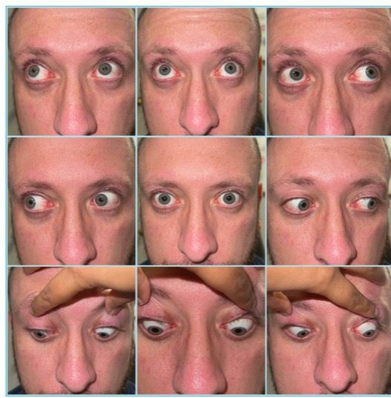

Slide 42
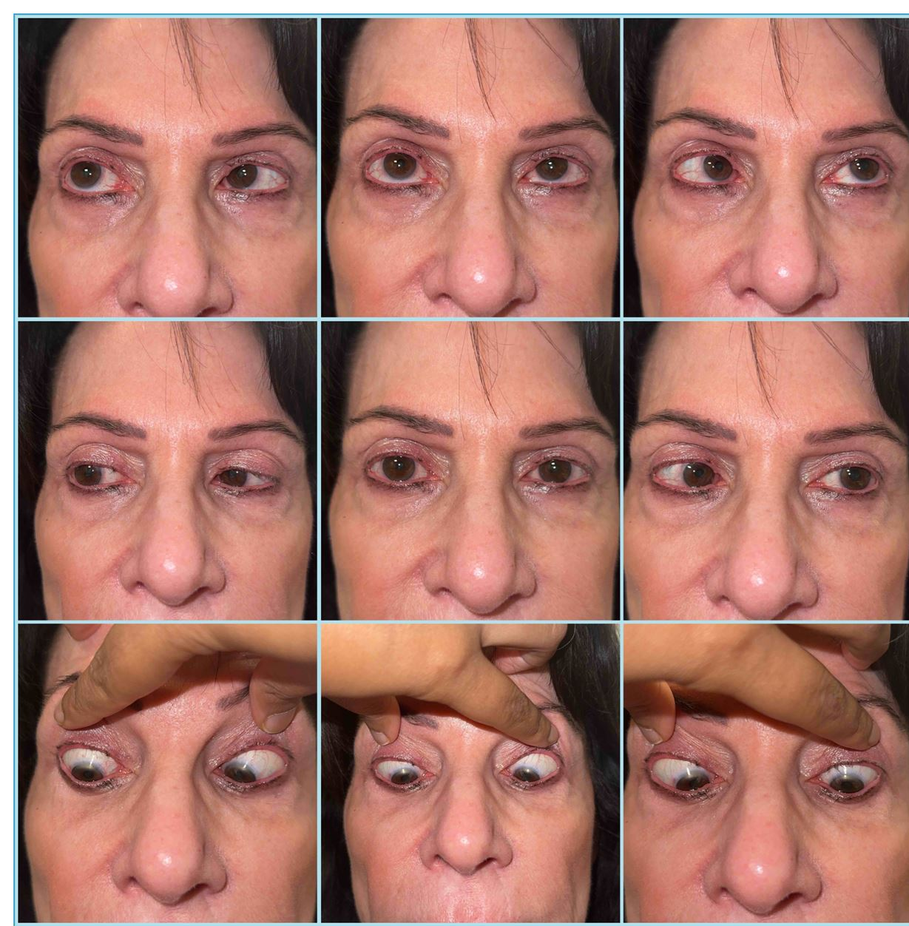
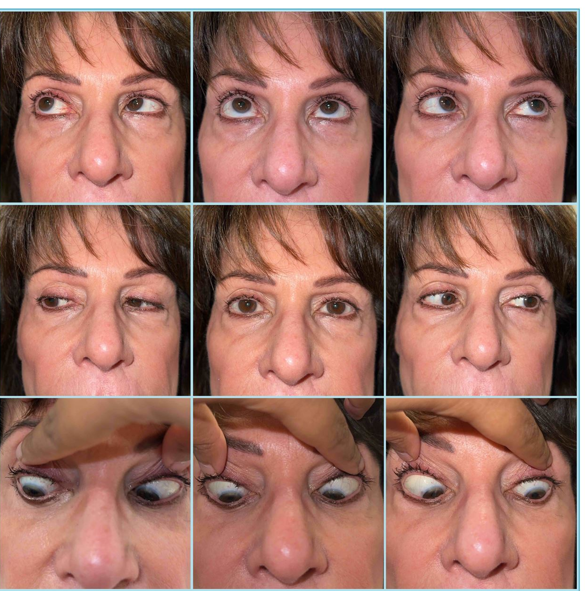
June 2023
July 2023

Slide 43
Internuclear Ophthalmoplegia (INO)
Adduction deficit with contralateral abducting nystagmus
Pathological side is the side with ADDuction deficit
Young patients = Demyelinating Disorder
Older patients = Stroke
Management: MRI Brain WWO with special attention to the MLF pathway
Treatment based on etiology
Demyelinating disease → Multiple Sclerosis, NMO, Anti-Mog
Stroke → risk factor management

Slide 44
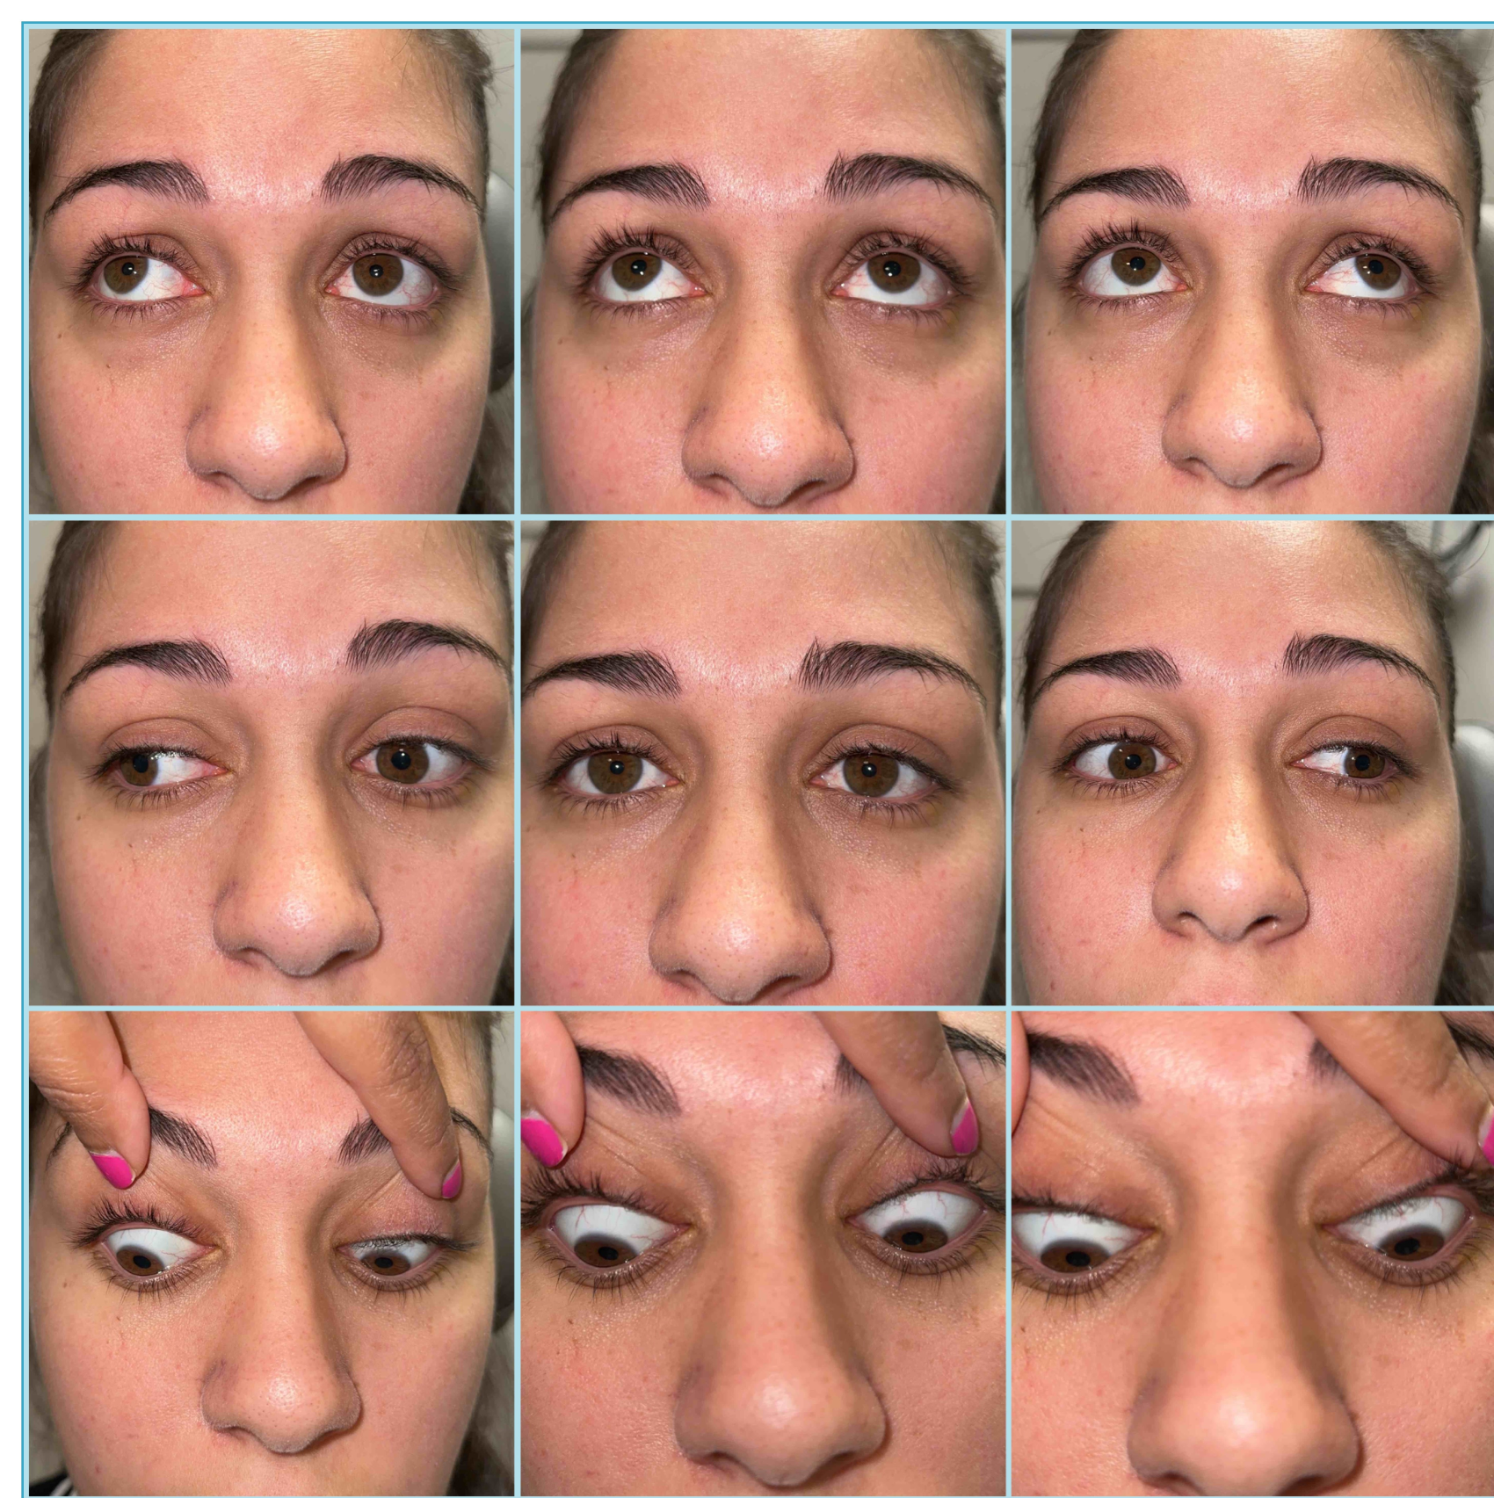

Slide 45
Paraneoplastic Disorder
Group of neurological disorders secondary to immune response to the nervous system associated with cancer
Prevalence < 1%
Frequently manifest prior to diagnosis however can also be signs of recurrence
Variable presentations
Classic presentations:
Opsoclonus-Myoclonus
Lambert-Eaton Myasthenic Syndrome
Limbic Encephalitis
Paraneoplastic Cerebellar Degeneration
Management: Serum and CSF paraneoplastic panel
Treatment:
Must treat underlying malignancy
IVIG
Cyclophosphamide

Slide 46
Paraneoplastic Sample Case

Slide 47
Part II
Optic Neuritis: The New Kids on the Block

Slide 48
I have no Financial disclosures.

Slide 49
Objectives
The Lay of the Land: Brief overview of optic neuritis
The Neighborhood as we Know It: Optic Neuritis Treatment Trial
Features: Presentation of optic neuritis (typical and atypical)
The New Kids: NMOSD, MOGAD
Road Map: Work up and management
Get Together: - Sample Cases

Slide 50
The Lay of the Land: Optic Neuritis

Slide 51
TERMS
Optic Neuritis: inflammation of the optic nerve
Papillitis
Inflammation of the anterior optic nerve
Optic nerve head edema
Retrobulbar Optic Neuritis
Inflammation behind the globe
Normal appearance of optic nerve

Slide 52
Optic Neuritis
Acute unilateral vision loss
Eye pain worse with eye movements (92.2% of patients in ONTT)
+/- neurological symptoms (e.g. paresthesias, numbness, weakness)
Uhthoff phenomenon
Etiologies:
Idiopathic
Demyelinating/inflammatory
Multiple Sclerosis*
Neuromyelitis Optica Spectrum Disorder (NMOSD)
Myelin oligodendrocyte glycoprotein antibody disorders (MOGAD)
Rare etiologies
Syphilis, Lyme, Cat-Scratch disease
Cryptococcus (rare since HAART therapy)
Paranasal infections
Zoster
Sarcoid
Notes:
Pain in ischemic optic neuropathy ~12% vs. ON ~92%
Most common optic neuropathy in patients < 50 y.o after glaucoma
Female: Male = 2:1

Slide 53
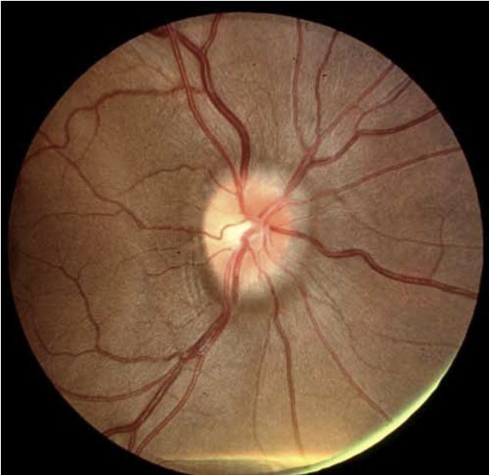
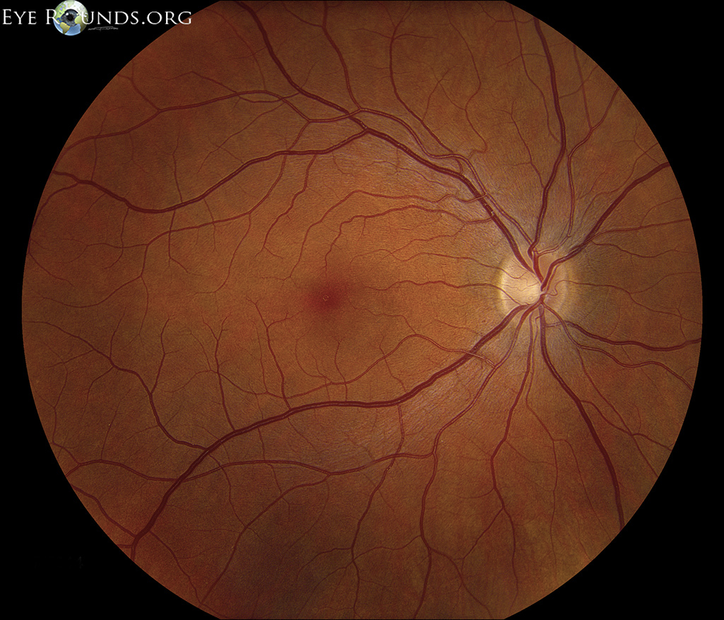
Exam findings
Vision loss (mild to no light perception)
Decreased color vision and contrast sensitivity (“washed out”)
Dyschromatopsia can be out of proportion to VA loss
Subtle cases: note relative speed; red/light desaturation
Relative afferent pupillary defect (APD)
Pain with eye movements
⅔ will have normal appearing Fundus and ON
⅓ with mild optic nerve edema

Slide 54
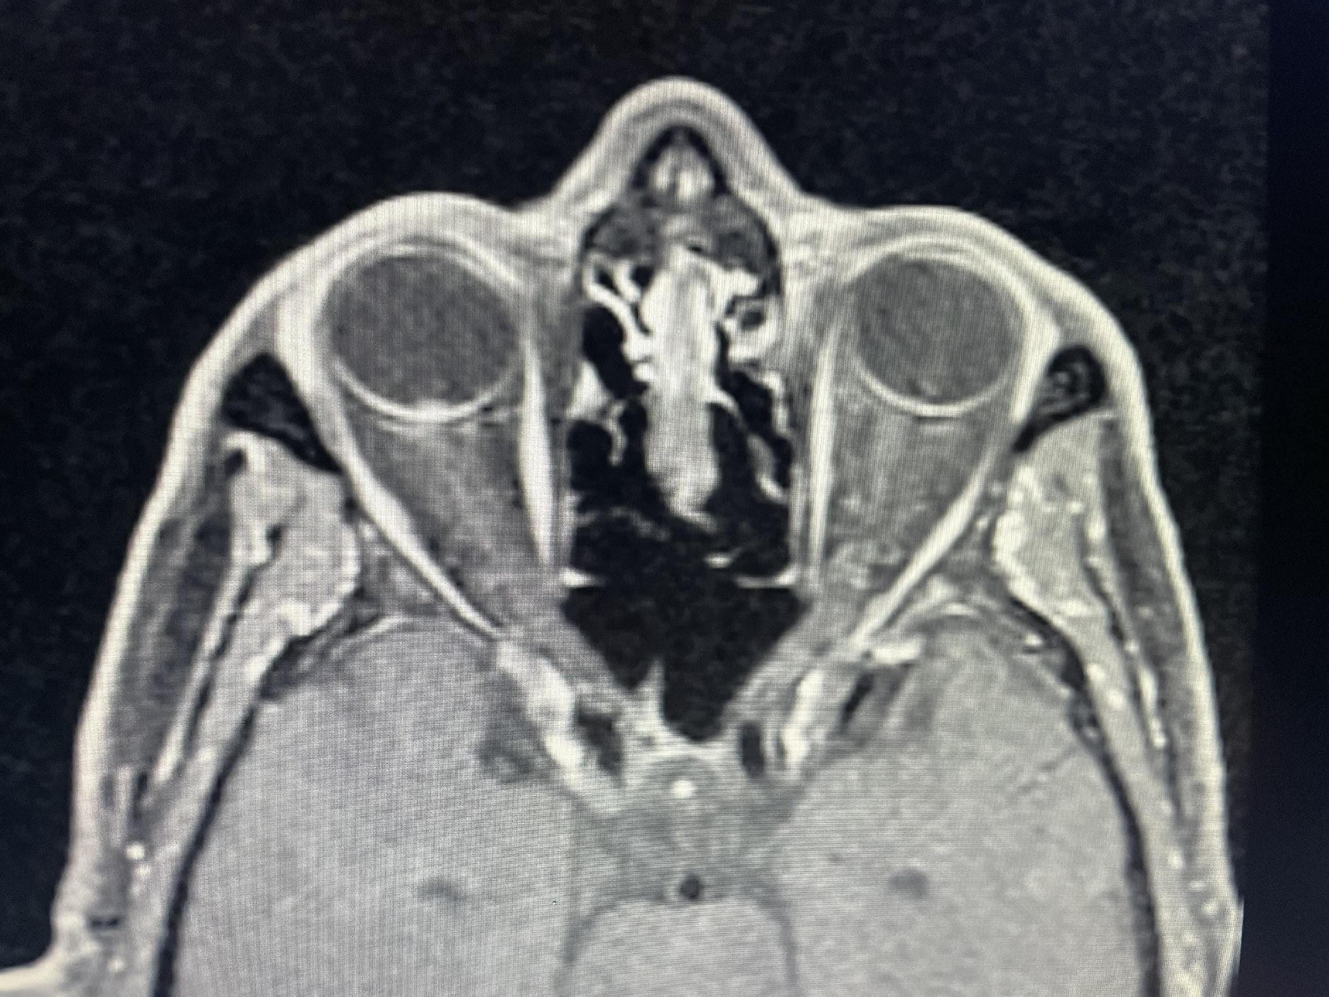
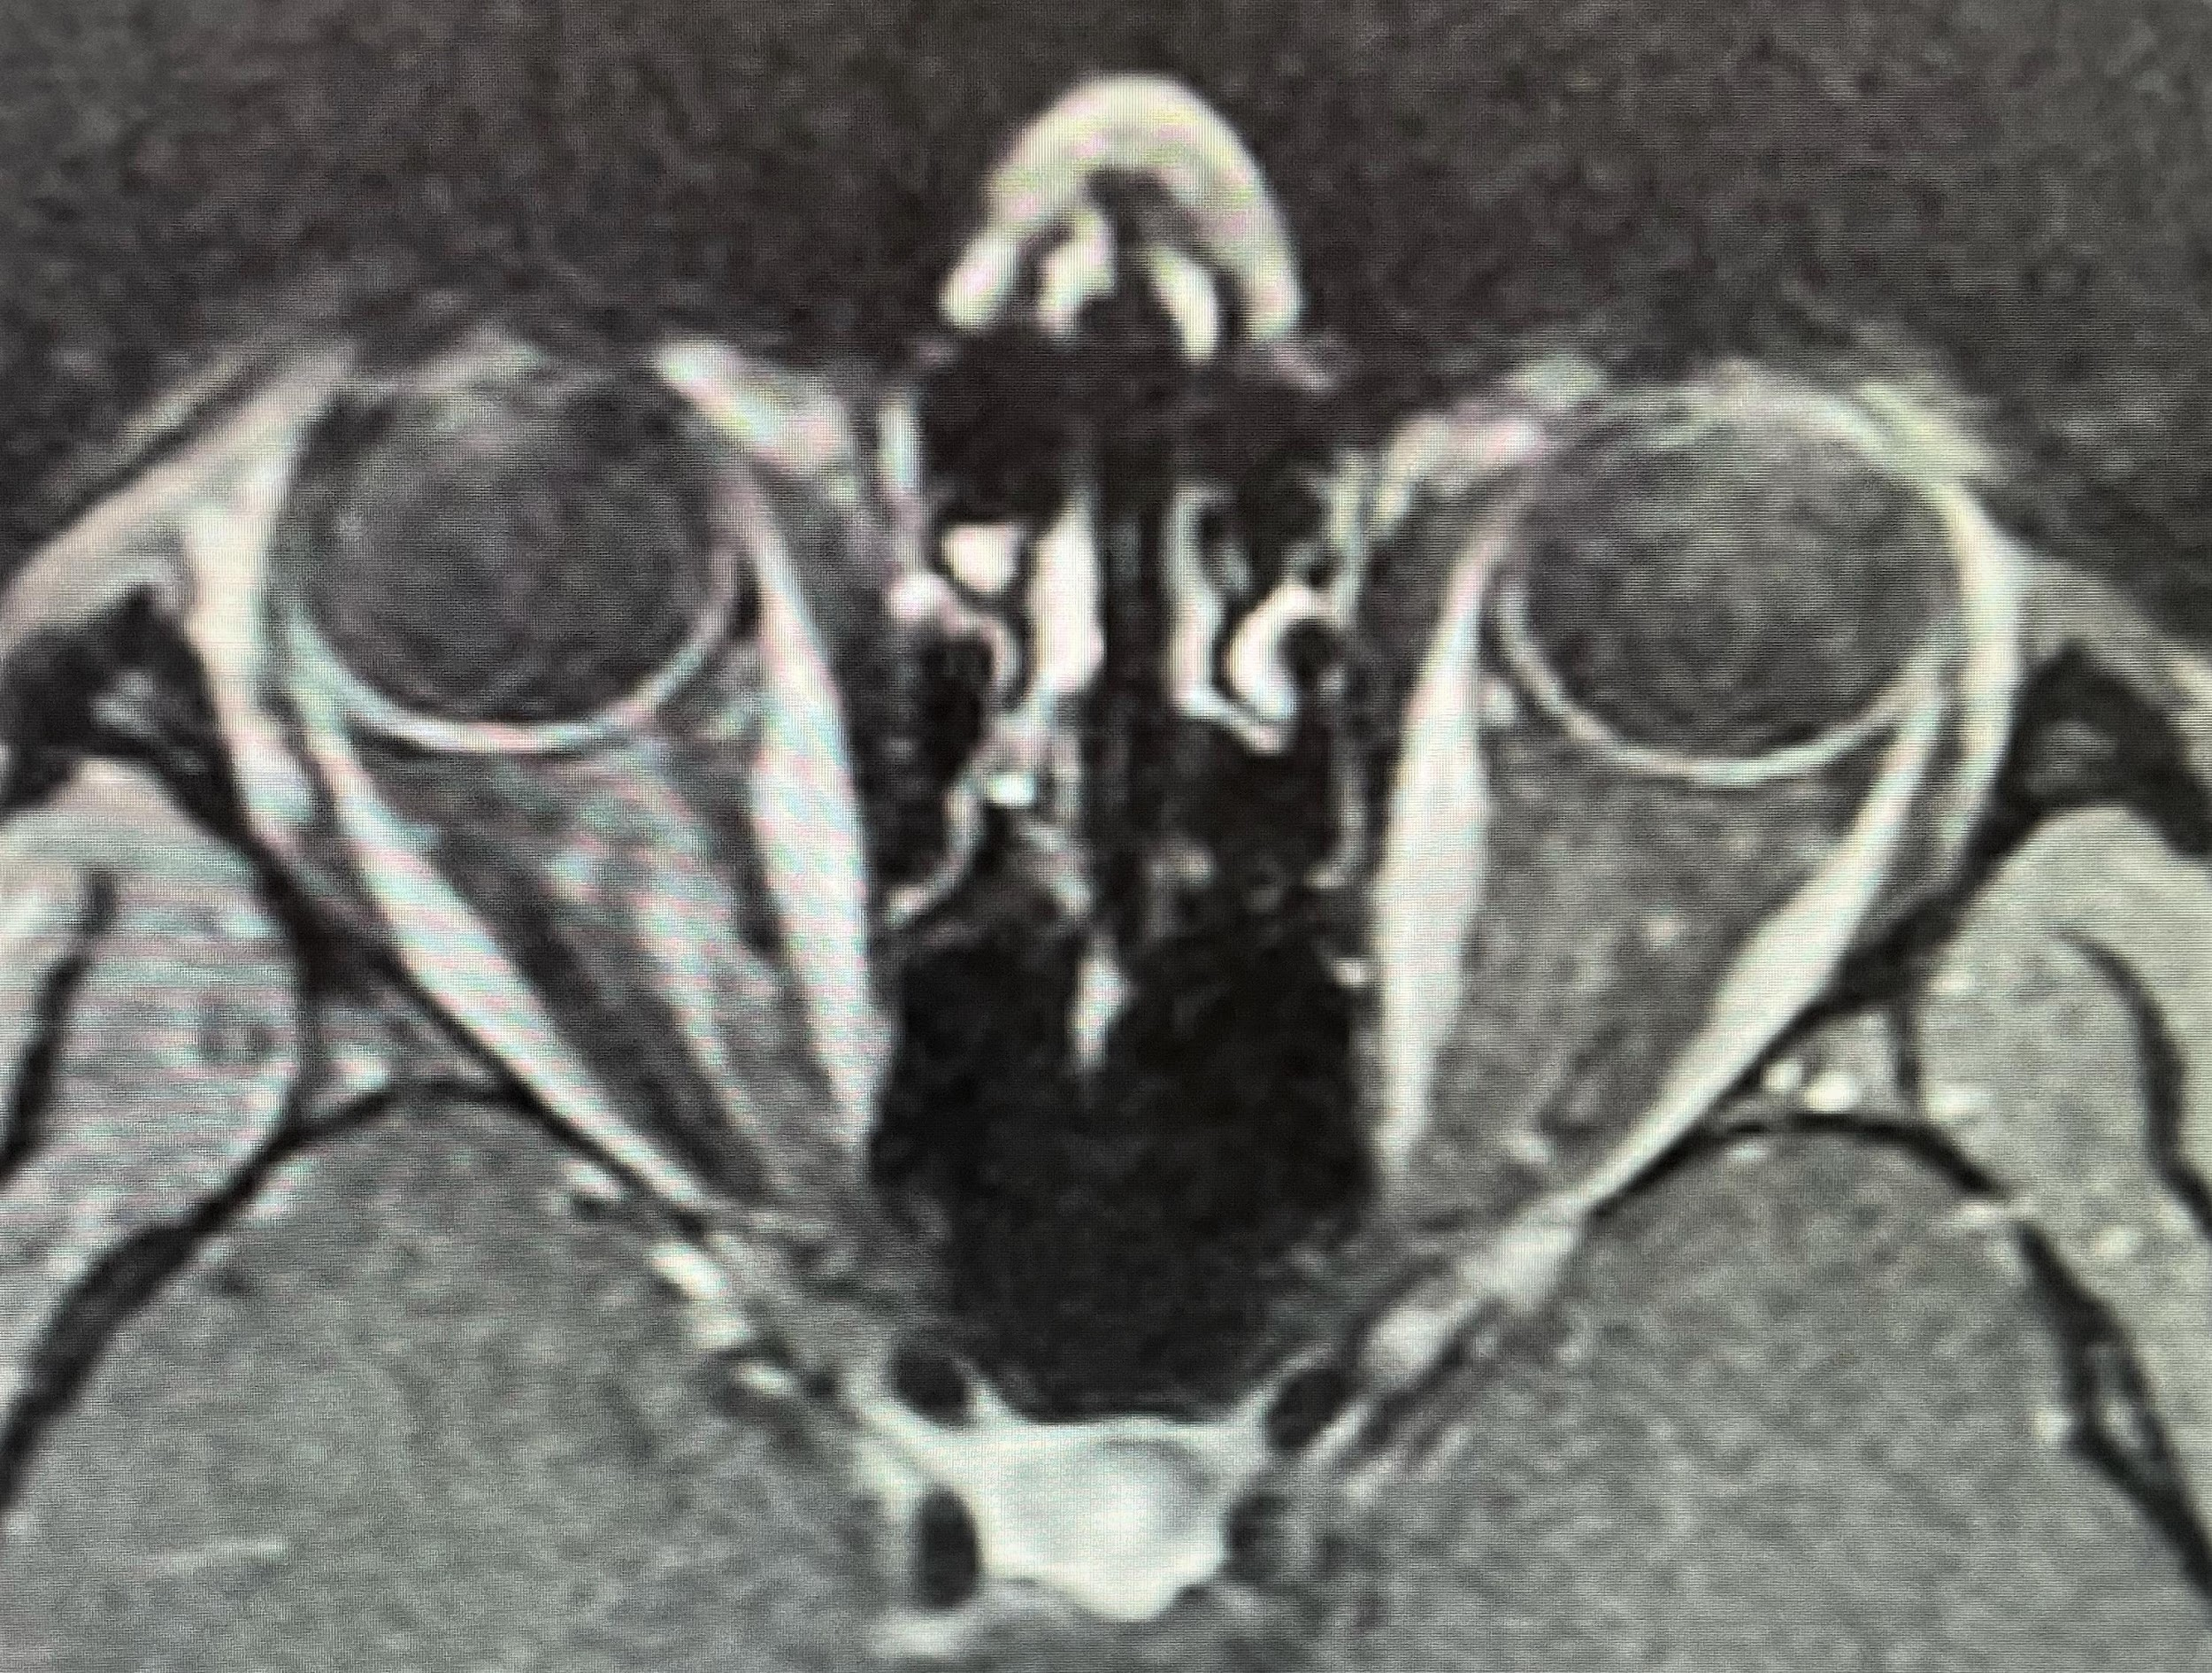
Papillitis
Optic Neuritis: retrobulbar
MRI post-contrast T1 axial images
Mild “bulge” at the optic nerve head only
DFE: optic disc edema OD only
Enhancement along the length of the ON extending posteriorly
DFE: normal appearance of optic nerve.

Slide 55
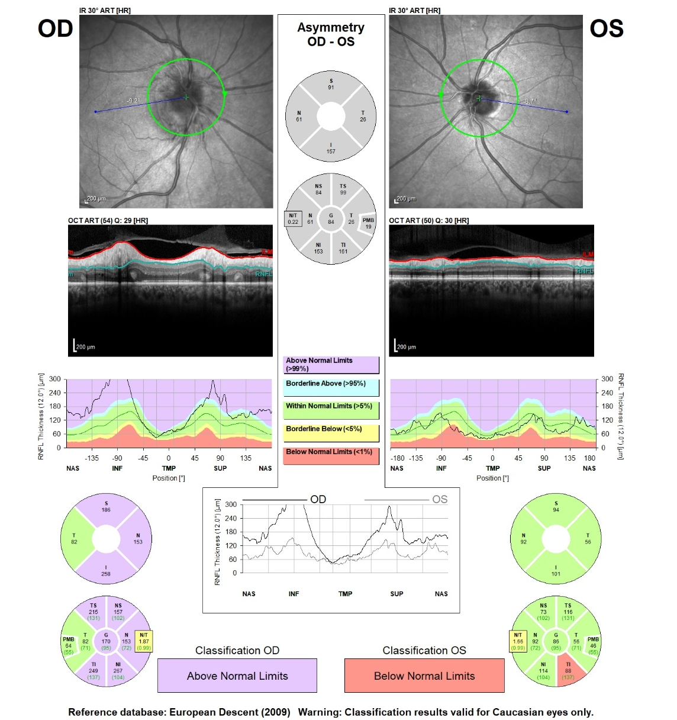
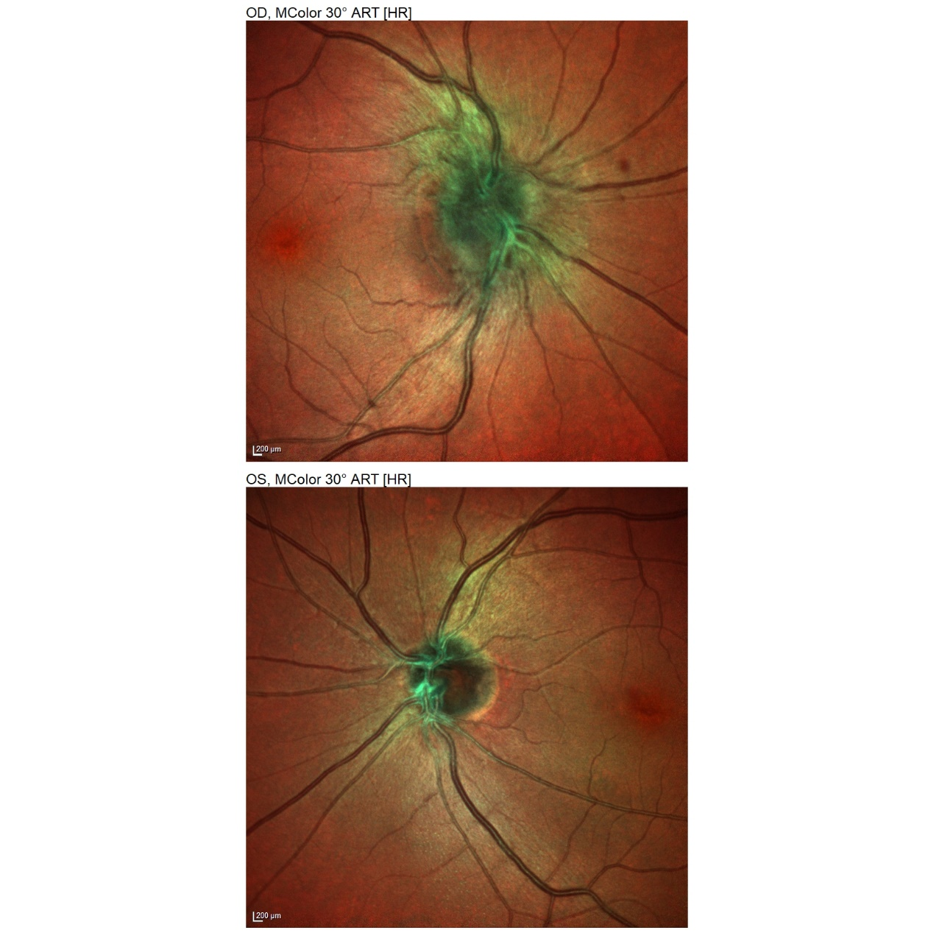

Slide 56
The Neighborhood As We Know It

Slide 57
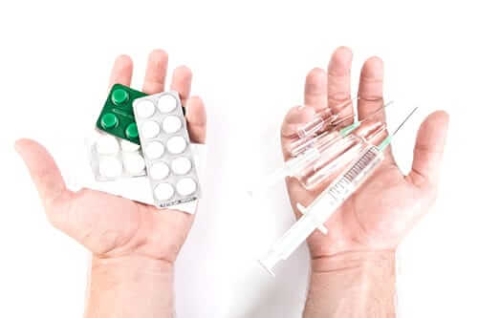
Blueprint: Optic Neuritis Treatment Trial
Prior to ONTT
Corticosteroids introduced into clinical practice in the 1950s
1986 United States survey: 65% of ophthalmologists & 90% of neurologists treated optic neuritis with corticosteroids
90% of the time in oral standard dosing
ONTT: first multicenter collaborative clinical trial in neuro-ophthalmology funded by NIH
1988 to 1991
15 US clinical centers randomized 457 acute optic neuritis patients within 8 days of onset to treatment with:
Oral Prednisone: 1 mg/kg daily x 14 days
Intravenous methylprednisolone (250 mg every 6 hours x 3 days) followed by oral prednisone (1mg/kg daily x 11 days)
Oral Placebo
Age: 18-45 years; mean =32
77% women
85% identified as Caucasian
No prior history of optic neuritis
No other systemic conditions other than MS (85% did not have a probable or definite MS diagnosis)

Slide 58
ONTT results
At 6 months, patients in all groups showed good recovery of vision.
Patients in the IV group recovered vision faster
By 30 days difference was insignificant
Oral prednisone group: 2x more likely to experience recurrent optic neuritis than other groups
Subpar dosing?
Time course:
Visual function after treated or untreated episode of optic neuritis recovers within the first 2 weeks of onset
Most recovery by end of 1 month & further slow recovery over several months (upto 1 yr)
Lack of recovery within the first 3 weeks after onset should be considered atypical

Slide 59
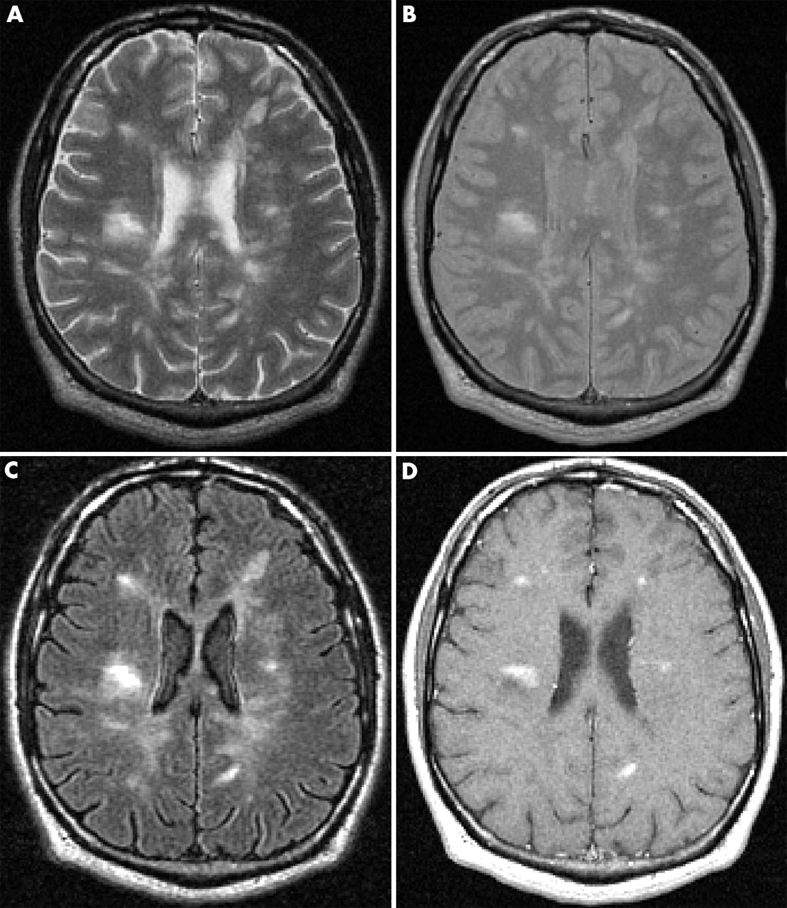
ONTT & MS risk over 15 years
Stratified risk of developing MS over 15 years:
Normal baseline brain MRI: 25%
Abnormal baseline MRI with 1 or more typical demyelinating lesions: strongest predictor with ~72% risk
IV steroid group showed a lower rate of development of clinically significant MS within the first 2 years

Slide 60
ONTT: “Clinical trial that keeps on giving”
Clinical characteristics of a large cohort of acute optic neuritis patients
Allow earlier recognition of atypical cases of ON
Natural history of the disorder
Clinical alert to all ophthalmologists/neurologists in 1992: lack of efficacy and risk of recurrent optic neuritis with oral prednisone
Bioequivalent prednisone is likely equivalent to IVMP
1 mg of Methylprednisolone = 1.25 mg of Prednisone
IV methylprednisolone mistakenly associated with better visual outcomes.
Subsequent risk of developing MS

Slide 61
Features

Slide 62
 | Typical Features | Atypical Features
Age | Young adult | <12 years or >50 years
Ethnic Origin | Caucasian | African American, Asian, Polynesian
Laterality | Unilateral Symptoms | Bilateral simultaneous Rapidly Sequential
Pain | Mild periocular pain worse on eye movement | Severe periocular pain Painless vision loss Pain persists > 2 weeks
Vision | Mild to moderate visual loss Rapid improvement over weeks | Severe visual loss (<20/200) No recovery within 3 wks of onset Progression of visual loss
Appearance | Normal or swollen optic disc | Severe optic disc swelling Macular star (neuroretinitis) Optic disc hemorrhages Retinal exudates Anterior-posterior segment inflammation
Other | Uhthoff’s phenomenon Pulfrich effect Previous self-limiting neurological episodes | Family history Neoplastic history

Slide 63
The New Kids On the Block

Slide 64
Neuromyelitis Optica (NMO)
Neuromyelitis Optica Syndrome Disorder (NMOSD)
Devic’s Disease: 1894 Eugene Devic described a case of bilateral blindness and paraplegia
Postmortem pathology: demyelination of optic nerves and necrosis of long portion of the spinal cord.
1999: First diagnostic criteria established
ON + transverse myelitis
Supportive imaging and CSF findings
Unclear if separate entity or more severe entity
2004: Aquaporin 4-IgG antibody against transmembrane water channel protein in the CNS expressed on astrocytic end-feet
Biomarker and pathologic cause of NMO
Distinguished NMO as a separate disease entity from MS
2015: NMO diagnostic criteria revised
Molecular and clinical diagnosis

Slide 65
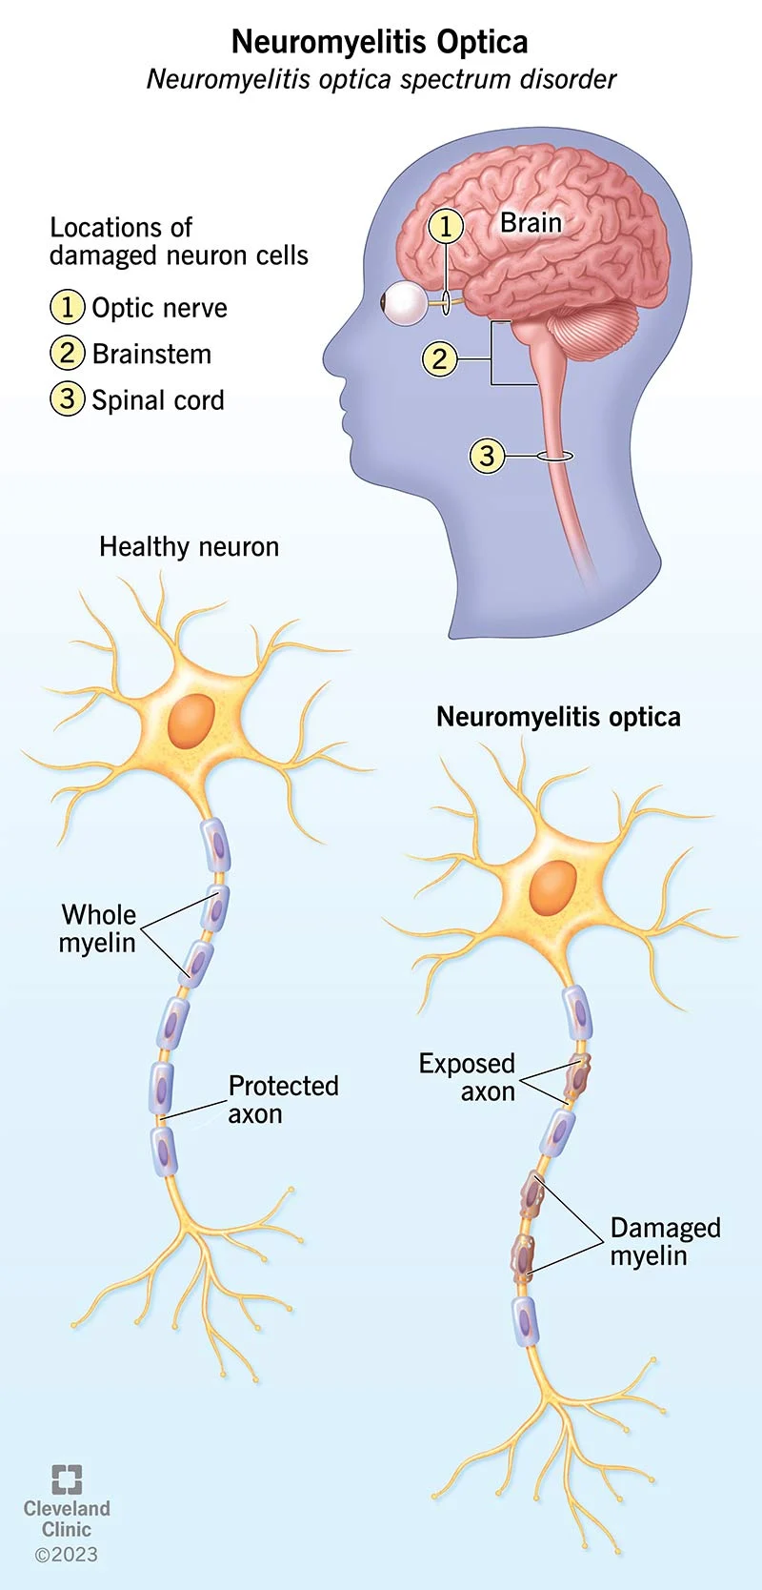
NMOSD
Rare, antibody-mediated autoimmune inflammatory disease affecting the CNS
Accounts for ~3% of optic neuritis cases
Median age of onset = 39 years (decade later than MS)
Strong female preference (70-90%)
Increased prevalence in Asians and African Americans
Sporadic disorder; some rare familial cases have been reported

Slide 66
NMOSD
~30% of NMOSD is seronegative for AQP4-IgG
Cell-based assay (sensitivity ~75%; specificity ~99%)***
Elisa
CSF evaluation: less sensitive and not cost effective; not recommended
Statistically significant correlation between AQP4 seropositivity & higher risk of ON & myelitis recurrence
Poorer visual outcome & overall disability
Relapsing course
Seen in upto 90% of patients
Most commonly occur in the first year after initial attack

Slide 67
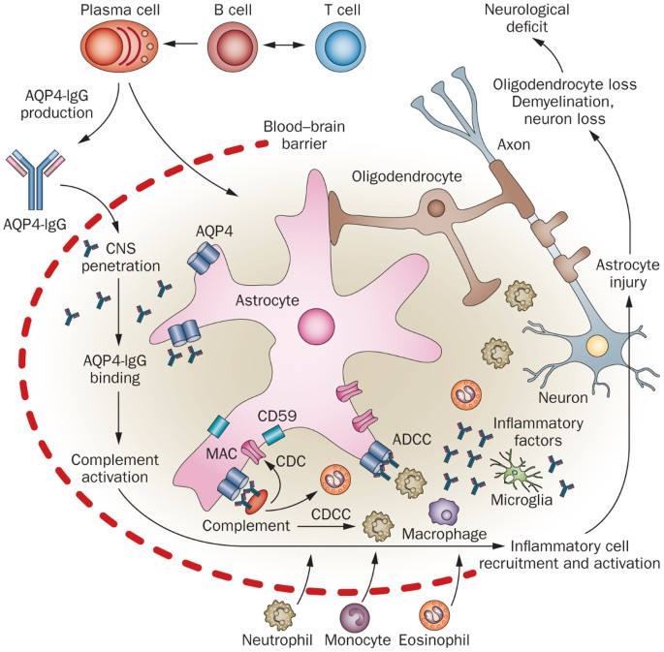

Slide 68
NMOSD: Core Clinical Characteristics
Diagnosis: 1 core clinical characteristic + positive serum Aqp4-IgG
Acute optic neuritis (initial presentation in 42% of patients)
⅔ of patients w/ NMOSD will eventually develop ON
Acute transverse myelitis
Area postrema syndrome: intractable nausea, vomiting and/or hiccups
Acute brainstem syndrome: Oculomotor dysfunction, other CN palsies
Acute diencephalic clinical syndrome or symptomatic narcolepsy
Symptomatic cerebral syndrome
Acute confusional state, delirium, seizures
Seronegative NMOSD Diagnosis: 2 core clinical characteristics w/ at least one of them being: ON, transverse myelitis or area postrema syndrome

Slide 69
NMOSD
>75% have VA < 20/200
⅓ have a final VA < 20/200 (vs. ONTT in which 90% improved to > 20/40)
Bilateral simultaneous presentation in ~20% vs. 1% in MS
Propensity to involve more posterior aspects of optic nerve on imaging
VF loss: variable
Central scotoma most common
Bitemporal from chiasmal involvement
OCT: average peripapillary RNFL loss is almost 2 fold higher than in MS
Macular ganglion cell and inner plexiform layer thinning 1.5 fold higher
Correlates with worse visual outcomes in NMOSD-ON

Slide 70
NMOSD: Neuroimaging findings
Simultaneous bilateral optic nerve enhancement
Longitudinally extensive enhancement (>50% of optic nerve)
Chiasmal involvement
Intracranial involvement:
Periventricular white matter lesions are rare
Increased in areas with high AQP4 expression:
Diencephalon surrounding 3rd ventricle and cerebral aqueduct
Posterior brainstem adjacent to 4th ventricle
Area postrema

Slide 71
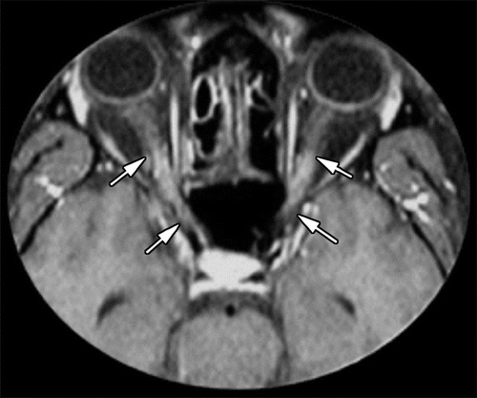
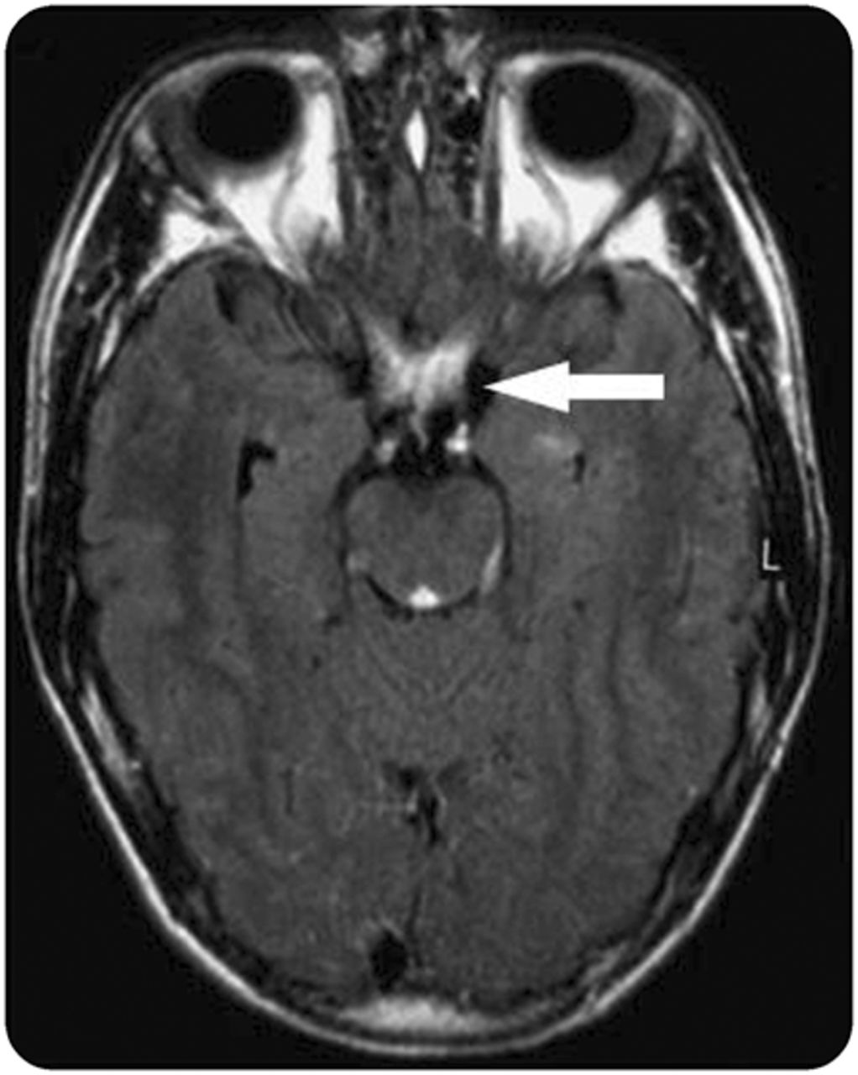

Slide 72
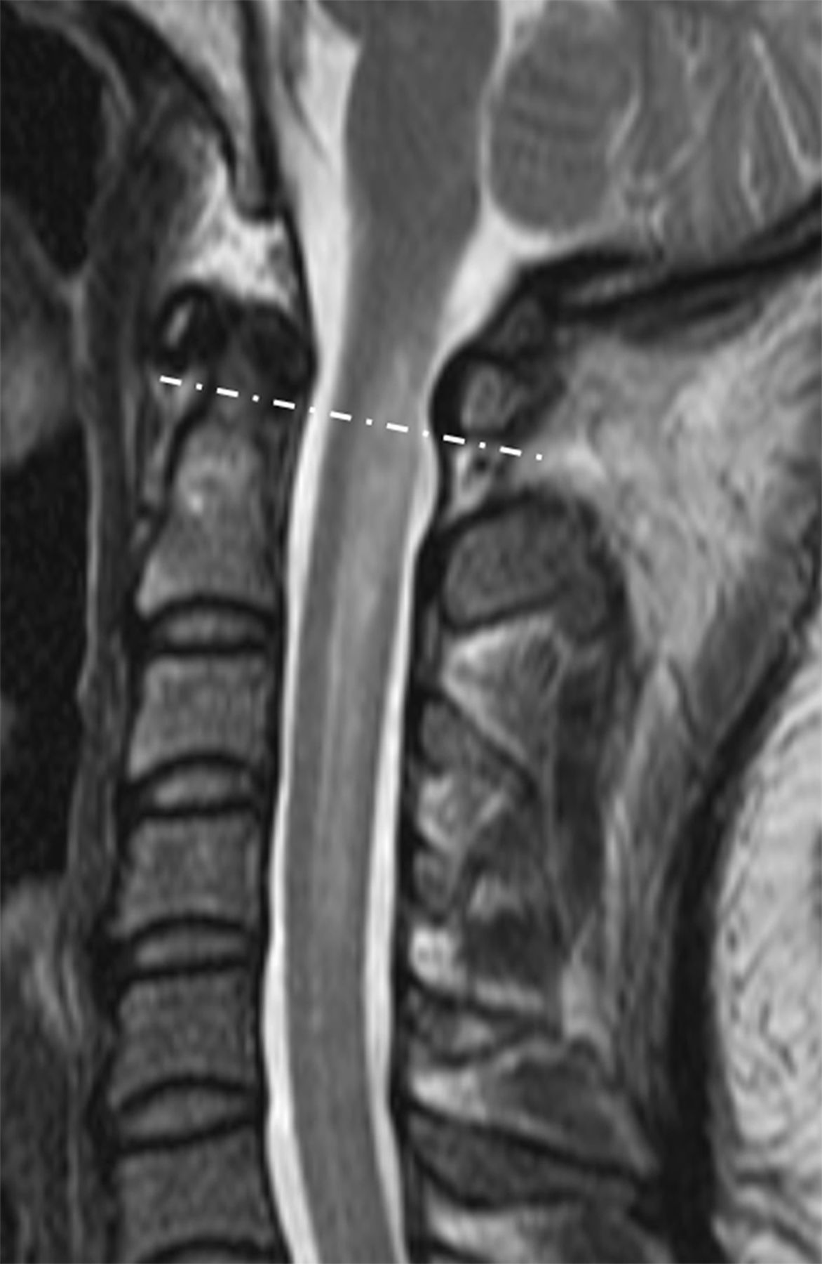
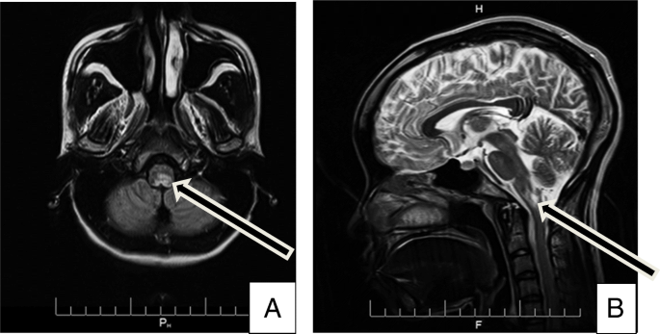

Slide 73
NMOSD: Treatment
IV methylprednisolone 1000 mg/day x 3 to 5 consecutive days
Plasma exchange (first line or in corticosteroid-refractory NMOSD-ON)
Typically administered every other day
Total of 5-7 sessions
Most beneficial if initiated within 7 days of symptom onset
Retrospective studies: better final VA when IVMP and plasma exchange used in combination than IVMP alone.
Early treatment important in reducing the risk of visual morbidity
ALL patients require long-term immunosuppressive therapy given rates of relapses and high risk of morbidity.

Slide 74
Immunosuppression therapy: NMOSD
Traditional off label therapies such as Cellcept & Azathioprine
Rituximab: monoclonal antibody against CD20 has been effective
most commonly employed treatment
Randomized clinical trials have led to FDA approved therapy with:
Inebilizumab (Uplinza): CD19 monoclonal antibody
90 minute infusion Q6 months after first two doses
77% relapse free at 28 weeks
Hepatitis B vaccination
Eculizumab (Soliris): anti-C5 complement inhibitor
35-minute infusion Q2 weeks
96.4% free of relapse vs 51.9% of controls at 96 wks
Meningococcal vaccination
Satralizumab (Enspryng): interleukin 6 receptor monoclonal antibody
Injection Q4 weeks after an initial dose of 3 shots in the first month
72% relapse free at 96 wks vs. 51% placebo
Hepatitis B and TB

Slide 75
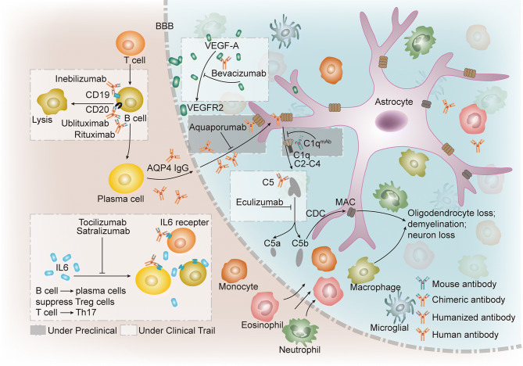
Zhu, Wenli, et al. “Monoclonal Antibody-Based Treatments for Neuromyelitis Optica Spectrum Disorders: From Bench to Bedside.” Neuroscience Bulletin, Oct. 2020, www.ncbi.nlm.nih.gov/pmc/articles/PMC7532256/.

Slide 76
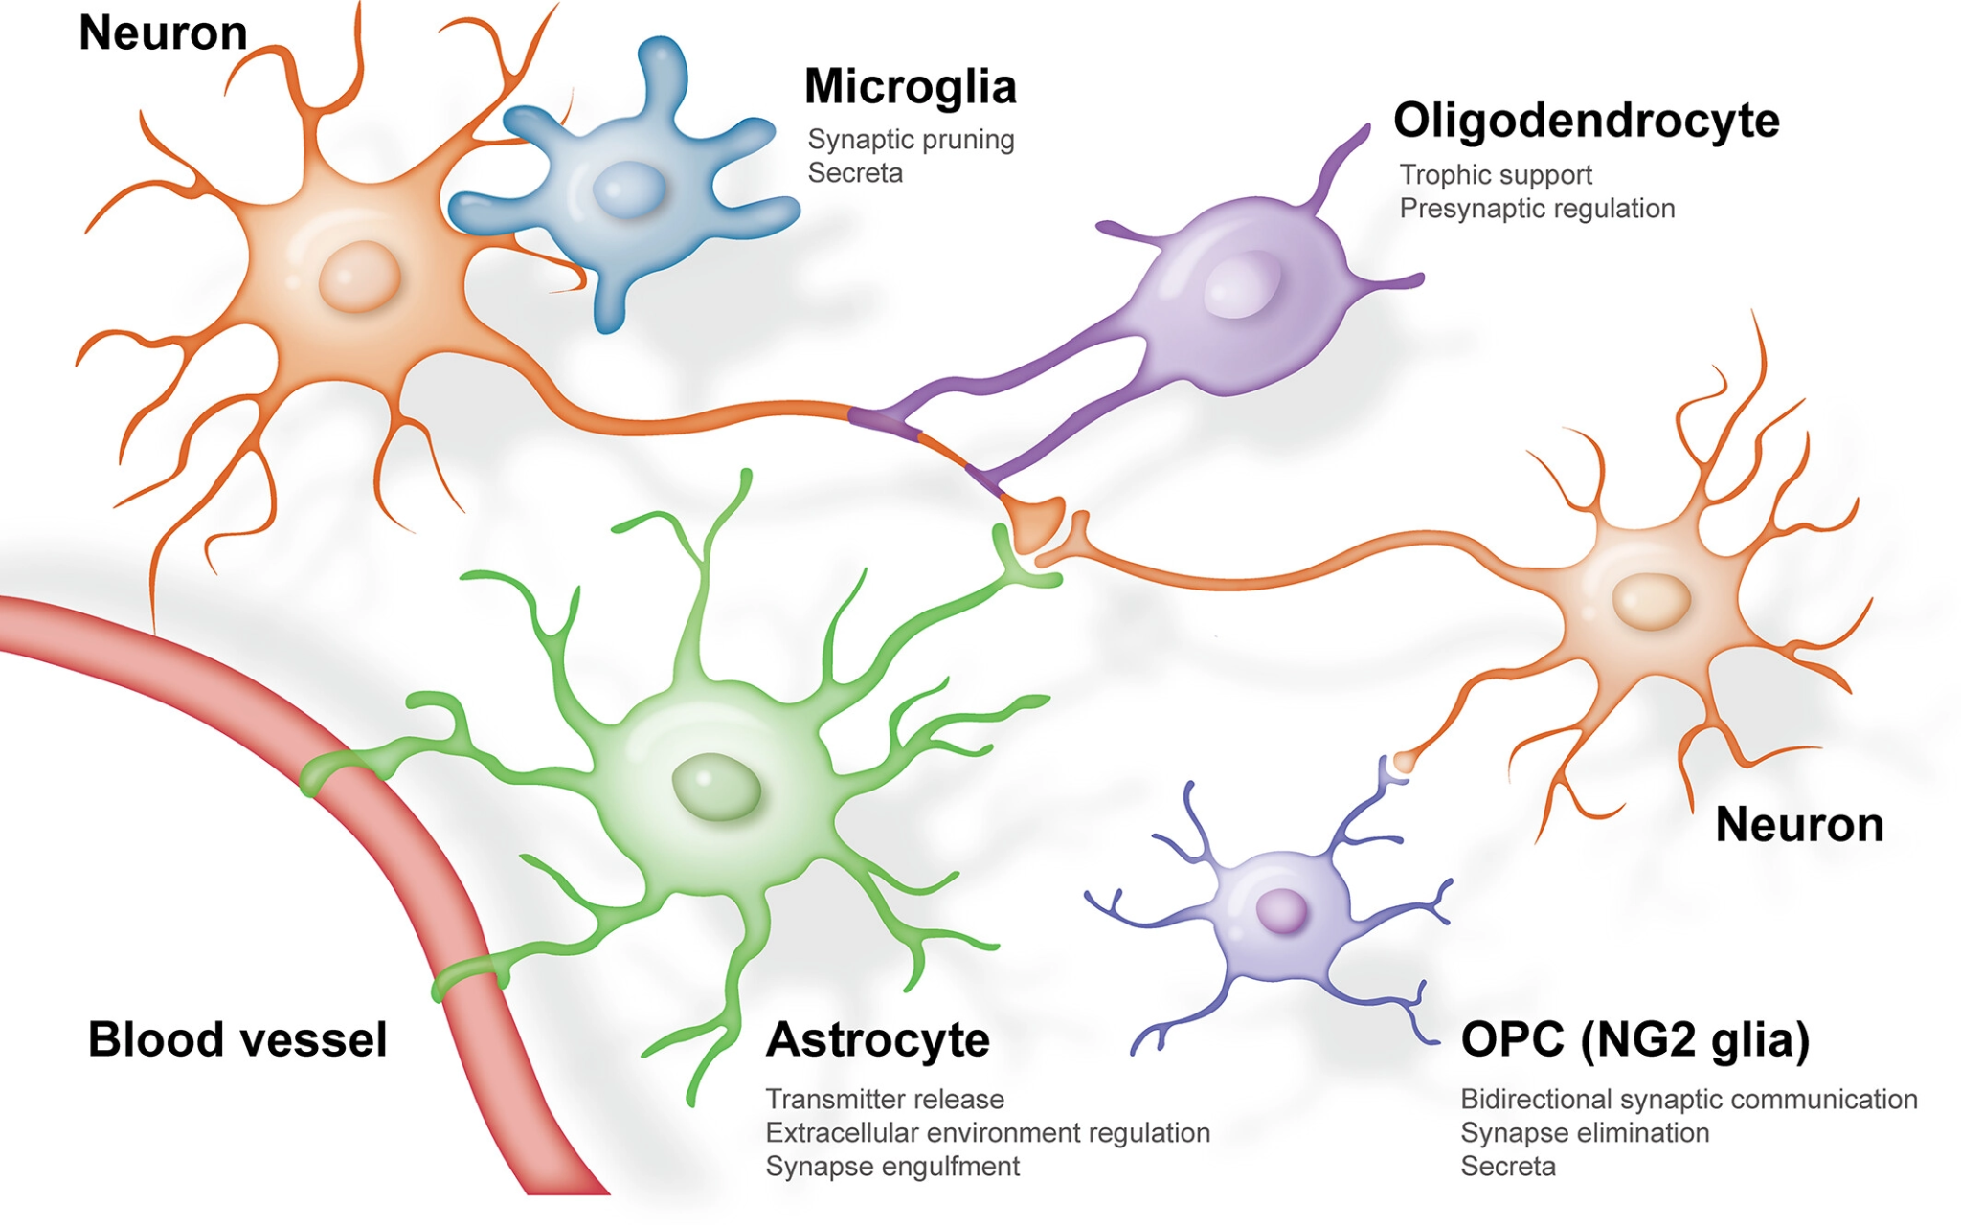
Myelin oligodendrocyte glycoprotein antibody associated disease (MOGAD)
Demyelinating disorder associated with anti-myelin oligodendrocyte glycoprotein (MOG) antibody
MOG found on outermost myelin sheath layers
Markers have been of interest since 1980s but not identified until 2007
Previously thought to be a marker of MS
Use of transfected cell-based assays with MOG has led to MOG-IgG as a reliable biomarker for the new entity MOGAS.
Widespread testing not available for years after discover.

Slide 77
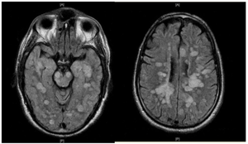
MOGAD
ADEM Presenting symptoms
Encephalopathy Mild:irritatbility, malaise, sleepiness Severe: somnolence/obtundation/coma Fever Weakness (diffuse or focal) Cranial nerve palsy Nausea/vomitting Meningeal signs Ataxia Seizures
Median age of onset mid-30s
No clear gender or racial predilection
In caucasian populations: 2-3x more common than AQP4-IgG + NMOSD
Clinical presentation
Adults → Optic neuritis is the most common phenotype
Accounts for 5% of adult optic neuritis cases
Paediatric population
Acute disseminated encephalomyelitis (ADEM) is more frequent → multiple foci of demyelination in brain/spinal cord
Optic neuritis accounts for 20-50% of paediatric optic neuritis cases

Slide 78
MOGAD
Optic Disc Edema ~80% of MOGAD-ON; may include peripapillary hemorrhages
50% can be bilateral
Pain is a prominent feature → can manifest as headache
Severe vision loss at nadir similar to NMOSD but often has significant recovery with better visual outcomes
~5-14% have a final VA of < 20/200
~50% will have relapsing disease, most commonly in the form of ON
ON episodes are often steroid responsive
Some are steroid dependent → follow a chronic relapsing inflammatory optic neuropathy(CRION)- like phenotype
MOGAD accounts for many cases of CRION previously thought to be idiopathic
Less common manifestations:
Uveitis, neuroretinitis, orbital inflammatory syndrome, cranial neuropathies, retinopathy 2/2 to venous stasis and increased ICP.

Slide 79
MOGAD Testing
Visual field: variable; central scotoma or severe generalised depression
OCT:
Acute phase: RNFL thickening consistent with optic disc edema
Thickness of >176 microns had 96% specificity of distinguishing MOGAD-ON from MS-ON
Chronic phase: progressive optic atrophy with RNFL and GCIPL thinning despite significant recovery of vision
Recurrent attacks required even though nadir VA maybe same as NMOSD to reach similar levels of thinning as seen in NMOSD
MRI
Longitudinally extensive enhancement typically involving > 50% of optic nerve in 90% of cases
Perineural enhancement involving the optic nerve sheath & peribulbar fat in 50% of cases
~15% of cases may extend posteriorly to involve chiasm
Unlike in NMOSD which more commonly causes isolated chiasmal involvement
Intracranial lesions can affect white and gray matter; typically large T2 weighted hyperintensities w/ indistinct margins
Serum and CSF fluid
Cell based assay: 98% specificity
Some cases are negative in the serum but positive in CSF; still under investigation

Slide 80
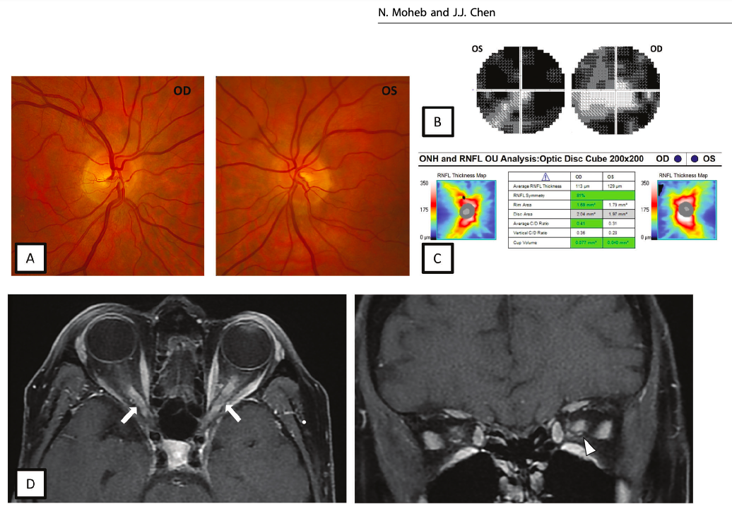

Slide 81
MOGAD Treatment
Acute: very responsive to high-dose corticosteroids(IVMP)
Early treatment may lead to better outcomes based on retrospective studies
Oral prednisone taper over 1-2 months often recommended due to both steroid response and dependence
Plasma exchange: significant vision loss with no improvement after high-dose IVMP
Chronic
Patients with relapsing disease or
Severe disease with significant disability after first attack
MS medications are ineffective similarly as in NMOSD
Treatment extrapolated from NMOSD:
Cellcept, Azathioprine, Rituximab (maybe less effective than in NMOSD)
Chronic prednisone is very effective but limited due to side effects
Case studies suggest targeting IL-6 with tocilizumab maybe helpful in refractory MOGAD
Retrospective studies: maintenance IVIG maybe most effective in relapsing cases

Slide 82
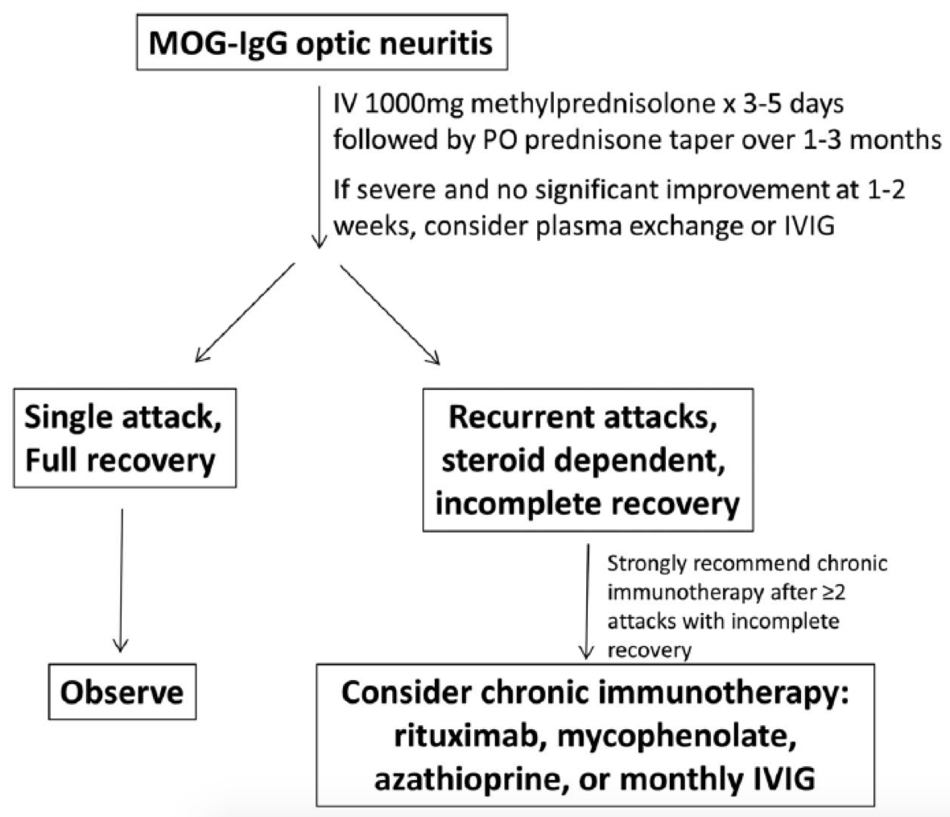

Slide 83
Road Map
R

Slide 84
 | MS-related | MOGAD | NMOSD
Age | 20s | Children, 30s | 40s
Visual outcomes | Good | Good 6-10% with VA<20/200 | Poor >33% with VA <20/200
Disc edema | 33% | 86% | 5-33%
Antibody | None | Anti-MOG ab | Anti-AQP4
Orbit MRI | Short | Long Perineural enhancement Orbital spillover | Long Chiasm, posterior optic nerve
Brain MRI | Periventricular white matter lesions Dawson fingers Juxtacortical U fibers | Hemispheric cerebral white matter lesions Periependymal diencephalon Dorsal medulla | Deep grey matter Diffuse brainstem Multifocal white matter lesions
Spine MRI | Short lesions Peripheral cord | LETM H sign Conus | LETM Central cord lesions
OCB | Yes | Rare | Rare
Other neuro sx |  | ADEM LETM | Area postrema LETM
Long term tx | Disease modifying agents | If recurrent – immunosuppression, IVIG | Immunosuppression

Slide 85
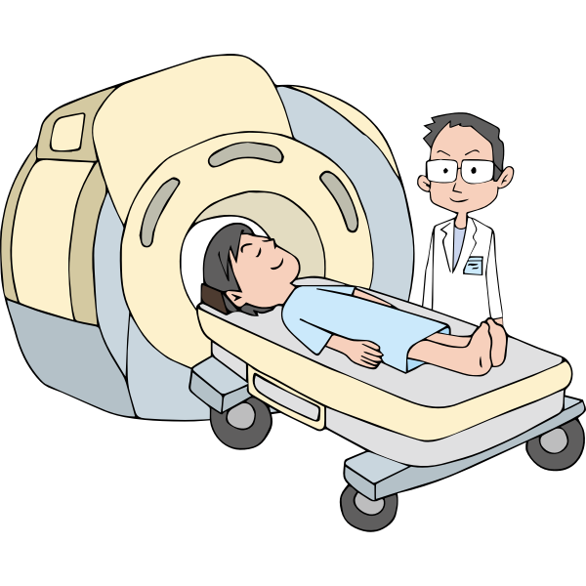
General Work-up Approach
Office evaluation: VA, color vision, pupillary assessment, dilated exam, VF testing, OCT
MRI Orbits with and without contrast: thin cuts, fat suppression
MRI Brain with and without contrast
+/- Spinal cord imaging
Lab work-up
ACE
RPR/FTA
Lyme
Quantiferon gold
+/- Anti-AQP4 antibodies
+/-Anti-MOG antibodies
+/- lumbar puncture

Slide 86
Generalized Management
Admit for IVMP x 3 days and assess response
If no improvement consider extending to 5 days
PLEX consideration on days 3-5
Prednisone taper on discharge
Based on suspicion evaluate for immunosuppression
Check appropriate vaccination status
Blood work
Follow-up in office

Slide 87
Get Together

Slide 88
A 29 year old woman with a history of hypertension presents with complaints of right eye pain on eye movement, impaired and blurry vision, and the feeling that some colors “do not look right.” On the “swinging light test,” when light is shone in her left eye, both pupils constrict normally. Then, when the light is quickly moved to the right eye, both pupils dilate slightly and the amount of constriction is much less as compared to when the light was shone in the left eye. Her visual acuity is impaired in the right eye, as is red color perception. Which of the following is the most likely cause of this finding?
Bilateral optic nerve disease
Severe bilateral macular disease
Left lateral geniculate body lesion
Right lateral geniculate body lesion
Right optic nerve disease

Slide 89
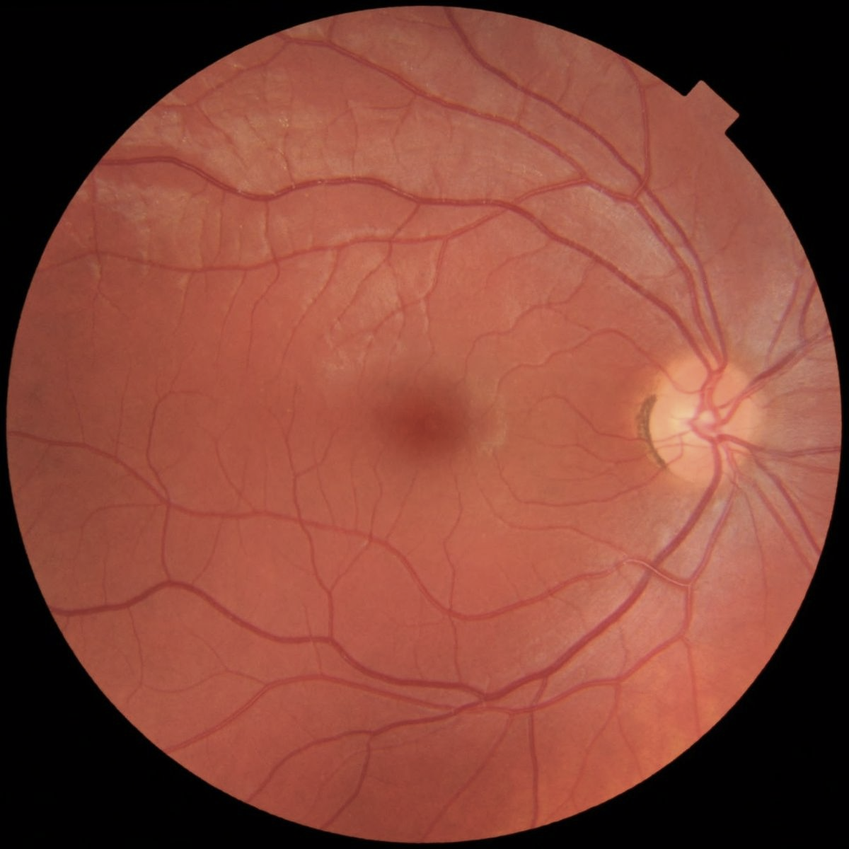
What diagnosis do you expect?
Papilledema
Giant Cell Arteritis
Acute Optic Neuritis
Anterior Ischemic Optic Neuropathy

Slide 90
MRI of the brain with contrast confirms your suspicion. Which of the following would be the most appropriate next course of treatment?
Oral Prednisone Taper
Intravenous methylprednisolone followed by an oral prednisone taper
Observation, initiate treatment at the next episode
Begin interferon therapy
Begin plasma exchange

Slide 91
Case Example
20 yo F with no PMHx presents new onset blur OS x 3 days, a/w pain with EOM

Slide 92
Neuro-Ophthalmic Exam
VA 20/20 OD, 20/40 OS
+1 APD OS, sluggish
Full Color plates OU; slower OD
Full CVF
EOM: full, pain OD

Slide 93
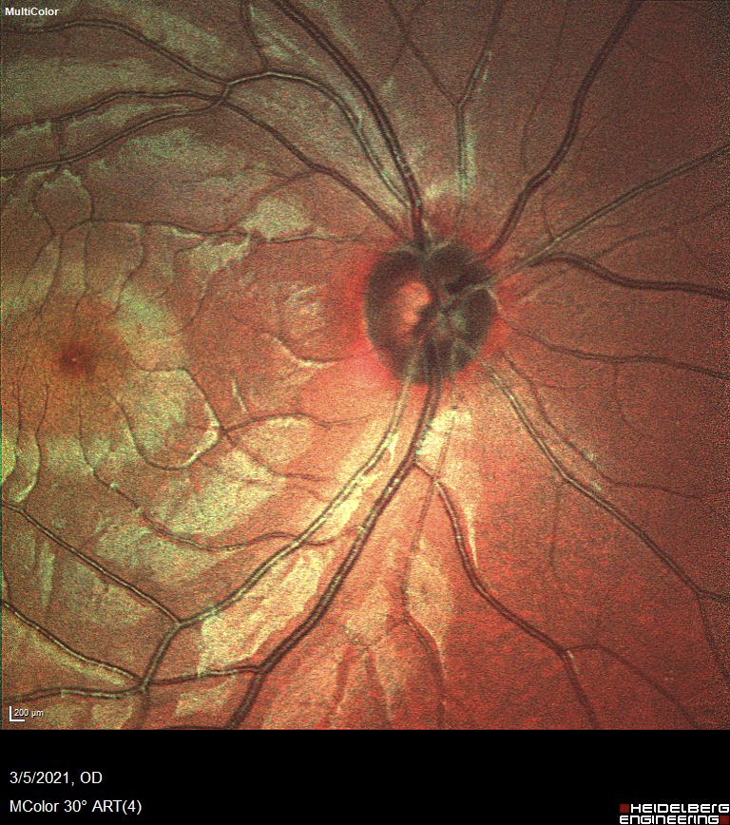
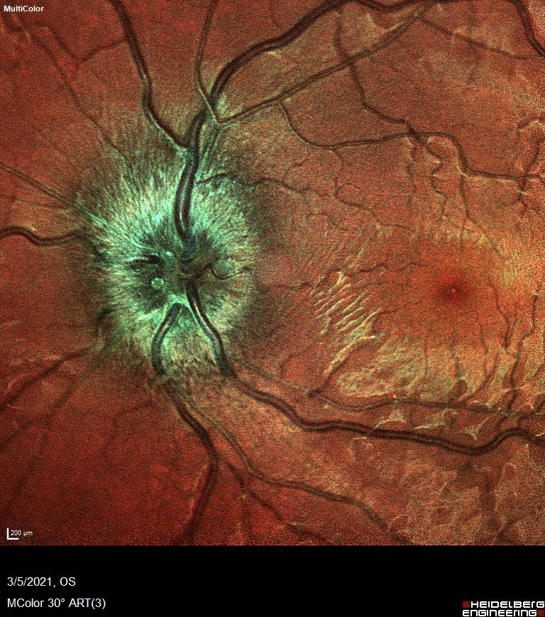
Typical or atypical?

Slide 94
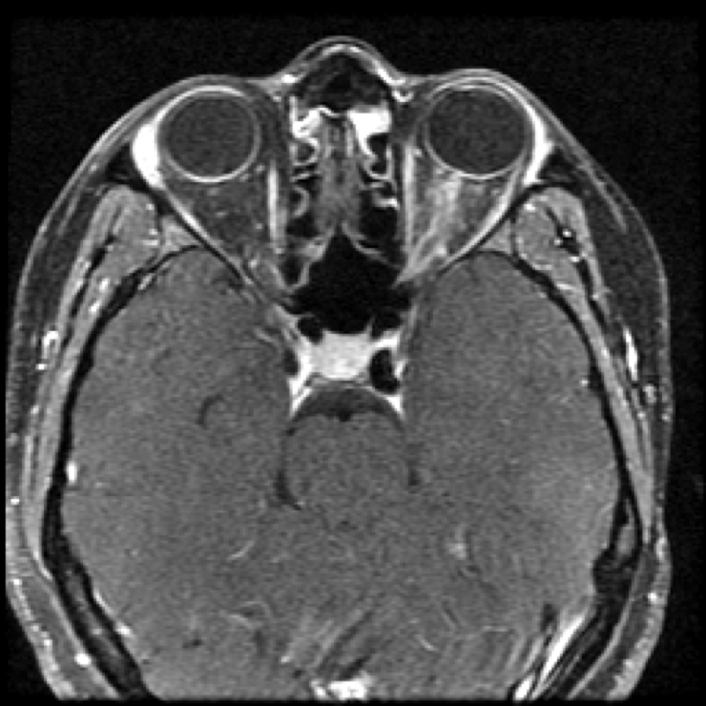
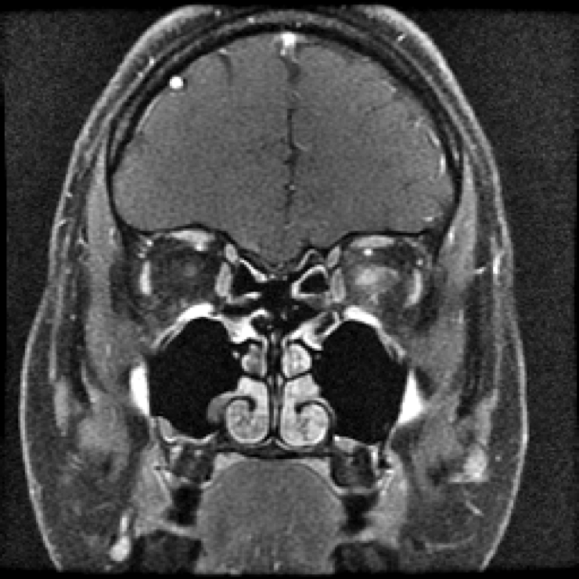

Slide 95
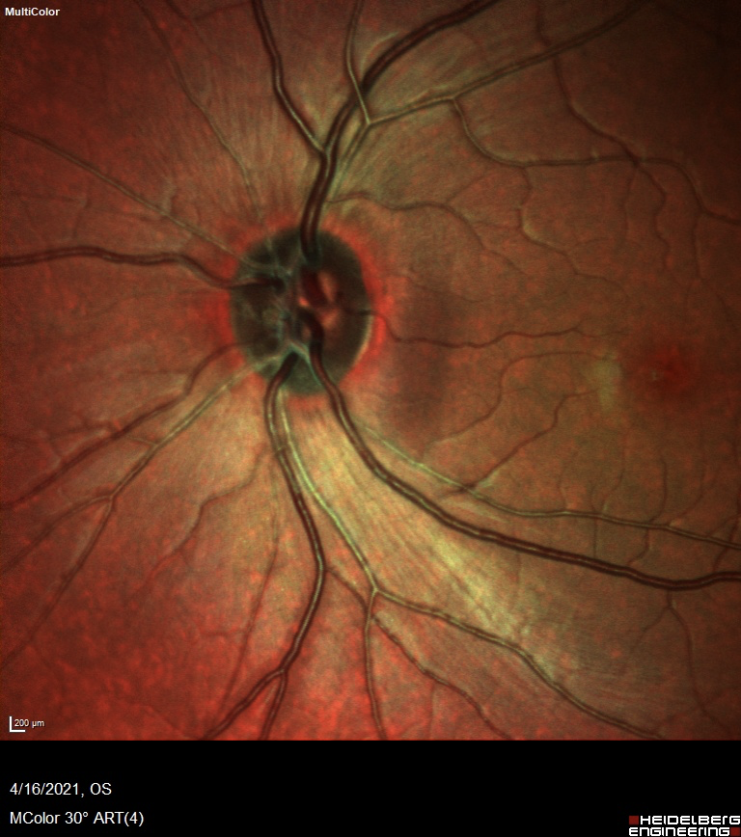
Admitted for IVMP x 3 days
Improved to 20/25 OD & pain free
Discharged on oral Prednisone taper:
60-40-20 q2 weeks
6 week follow-up:
20/20 OU
No APD
Pain free
Workup:
Sypilis/Lyme/TB negative
ACE 17
MoG Antibody: positive >1:160
Aquaporin 4 antibody titer negative.

Slide 96
Case Example
48 yo F with PMHx of vitiligo presenting with painless progressive vision loss OS x 1 week associate with flashes.
Thoughts?

Slide 97
Neuro-Ophthalmic Exam
VA 20/20 OD, HM OS
+APD OS
Dense scotoma on CVF
Unable to do color plates
Normal Fundus exam in both eyes
Typical or Atypical?

Slide 98
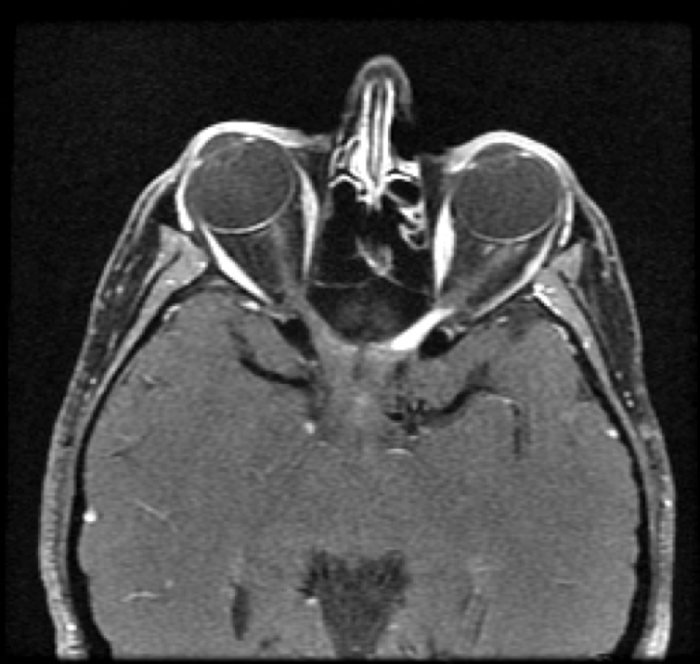
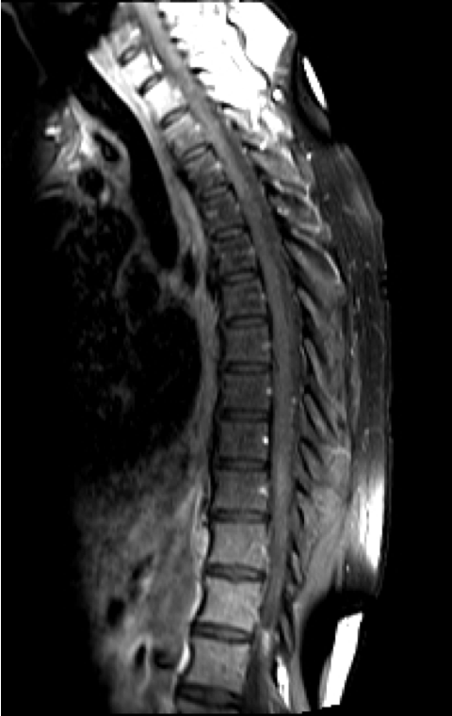
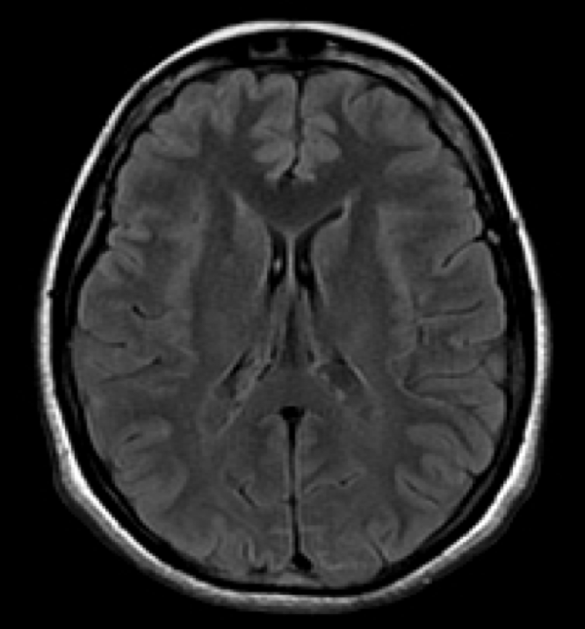
Hospital course
LP: normal; 3 oligoclonal bands
Admitted for IVMP x 5 days
VA CF 3 ft
Plasmapheresis x 5 sessions
VA OS 20/50
Discharged on slow steroid taper: 60/40/20/10 q2wks
4 week f/u: VA 20/20
Aquaporin 4 antibody titer: positive titer 1:10,000

Slide 99
NMO??
How west is west?
MOG??
MS??
Tuttle?
North port??

Slide 100
Take home points
Optic neuritis is an inflammatory condition typically associated with demyelinating condition
most commonly Multiple Sclerosis
Clinical diagnosis, but MRI findings helpful especially in NMO/MOG
First line treatment is IV steroids regardless of etiology
PLEX based on visual recovery and response to IVMP
Low threshold for NMO/MOG testing especially in atypical cases
NMO can be a devastating disease thus important to evaluate patients for it.
MS disease modifying medications do not work in NMOSD/MOGAD
Long-term suppression based on disease process/course

Slide 101
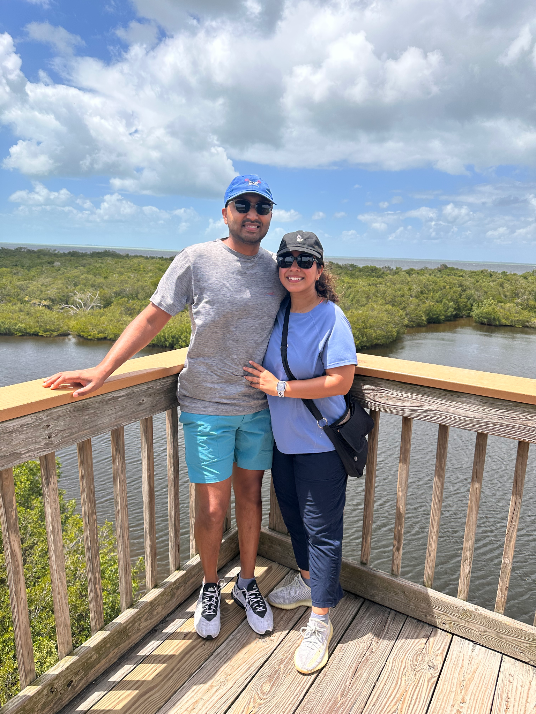

Slide 102
References
Liu, G., Volpe, NJ., Galetta, SL. 2019. Liu, Volpe, and Galetta’s Neuro-Ophthalmology Diagnosis and Management. (3rd edition). Elsevier.
Basic and Clinical Science Course Section 4: Neuro-Ophthalmology. 2016-2017. American Academy of Ophthalmology.
Optic Neuritis Study Group (2008). Multiple sclerosis risk after optic neuritis: final optic neuritis treatment trial follow-up. Archives of neurology, 65(6), 727–732. https://doi.org/10.1001/archneur.65.6.727
Beck, R. W., & Gal, R. L. (2008). Treatment of acute optic neuritis: a summary of findings from the optic neuritis treatment trial. Archives of ophthalmology (Chicago, Ill. : 1960), 126(7), 994–995. https://doi.org/10.1001/archopht.126.7.994
Beck RW, Cleary PA, Trobe JD, Kaufman DI, Kupersmith MJ, Paty DW, Brown CH,. (1993). The effect of corticosteroids for acute optic neuritis on the subsequent development of multiple sclerosis. New England Journal of Medicine. 329(24): 1764-1769.
Holroyd, K. B., Manzano, G. S., & Levy, M. (2020). Update on neuromyelitis optica spectrum disorder. Current opinion in ophthalmology, 31(6), 462–468. https://doi.org/10.1097/ICU.0000000000000703https://www.ncbi.nlm.nih.gov/pmc/articles/PMC4515040/
Huda, S., Whittam, D., Bhojak, M., Chamberlain, J., Noonan, C., & Jacob, A. (2019). Neuromyelitis optica spectrum disorders. Clinical medicine (London, England), 19(2), 169–176. https://doi.org/10.7861/clinmedicine.19-2-169
Chan, K. H., & Lee, C. Y. (2021). Treatment of Neuromyelitis Optica Spectrum Disorders. International journal of molecular sciences, 22(16), 8638. https://doi.org/10.3390/ijms22168638
Pittock, S. J., & Lucchinetti, C. F. (2016). Neuromyelitis optica and the evolving spectrum of autoimmune aquaporin-4 channelopathies: a decade later. Annals of the New York Academy of Sciences, 1366(1), 20–39. https://doi.org/10.1111/nyas.12794
Jarius, S., Franciotta, D., Paul, F., Ruprecht, K., Bergamaschi, R., Rommer, P. S., Reuss, R., Probst, C., Kristoferitsch, W., Wandinger, K. P., & Wildemann, B. (2010). Cerebrospinal fluid antibodies to aquaporin-4 in neuromyelitis optica and related disorders: frequency, origin, and diagnostic relevance. Journal of neuroinflammation, 7, 52. https://doi.org/10.1186/1742-2094-7-52
Sechi E, Cacciaguerra L, Chen JJ, Mariotto S, Fadda G, Dinoto A, Lopez-Chiriboga AS, Pittock SJ and Flanagan EP (2022) Myelin Oligodendrocyte Glycoprotein Antibody-Associated Disease (MOGAD): A Review of Clinical and MRI Features, Diagnosis, and Management. Front. Neurol. 13:885218. doi: 10.3389/fneur.2022.885218
Ambrosius, W., Michalak, S., Kozubski, W., & Kalinowska, A. (2020). Myelin Oligodendrocyte Glycoprotein Antibody-Associated Disease: Current Insights into the Disease Pathophysiology, Diagnosis and Management. International journal of molecular sciences, 22(1), 100. https://doi.org/10.3390/ijms22010100
Morrow, S. A., Fraser, J. A., Day, C., Bowman, D., Rosehart, H., Kremenchutzky, M., & Nicolle, M. (2018). Effect of Treating Acute Optic Neuritis With Bioequivalent Oral vs Intravenous Corticosteroids: A Randomized Clinical Trial. JAMA neurology, 75(6), 690–696. https://doi.org/10.1001/jamaneurol.2018.0024
Zhu, Wenli, et al. “Monoclonal Antibody-Based Treatments for Neuromyelitis Optica Spectrum Disorders: From Bench to Bedside.” Neuroscience Bulletin, Oct. 2020, www.ncbi.nlm.nih.gov/pmc/articles/PMC7532256/.

Slide 103
Thank You!

